Slide 1
Aspects of Chequerbent History
Garth Ratcliffe

Slide 2
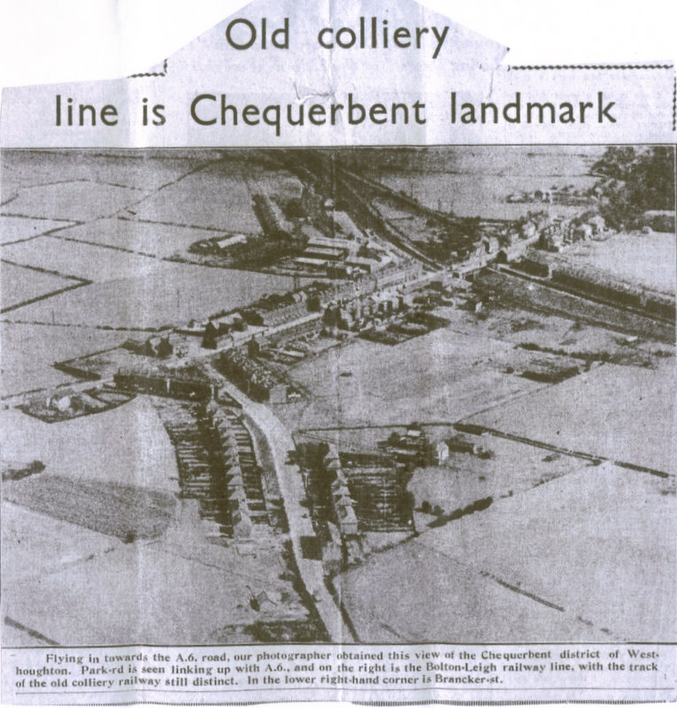

Slide 3
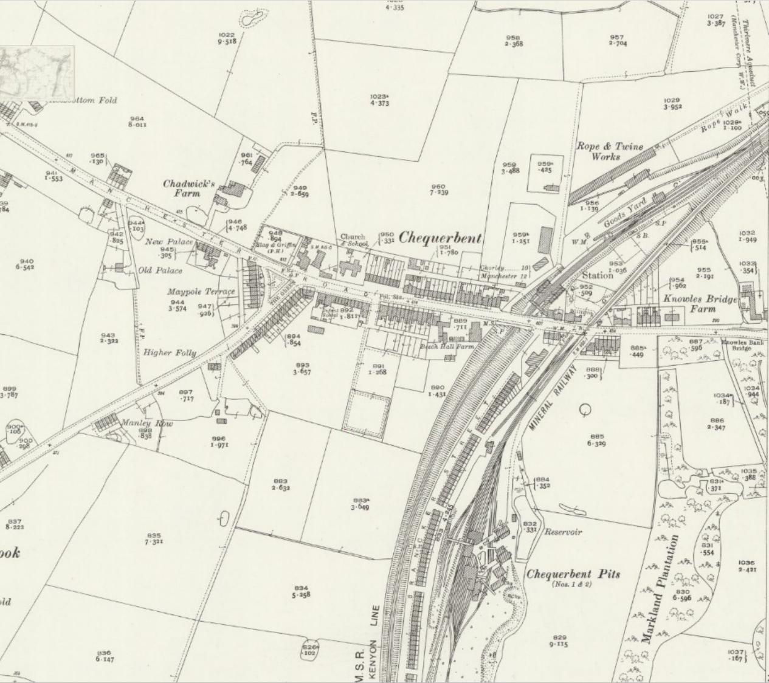
1929 OS map of Chequerbent
Note the Chequerbent Pits Nos 1 and 2 behind Brancker Street.

Slide 4
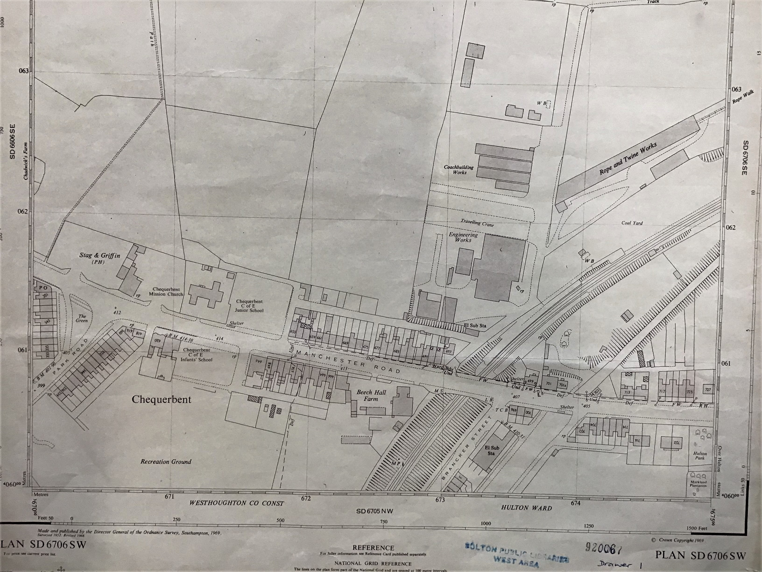

Slide 6
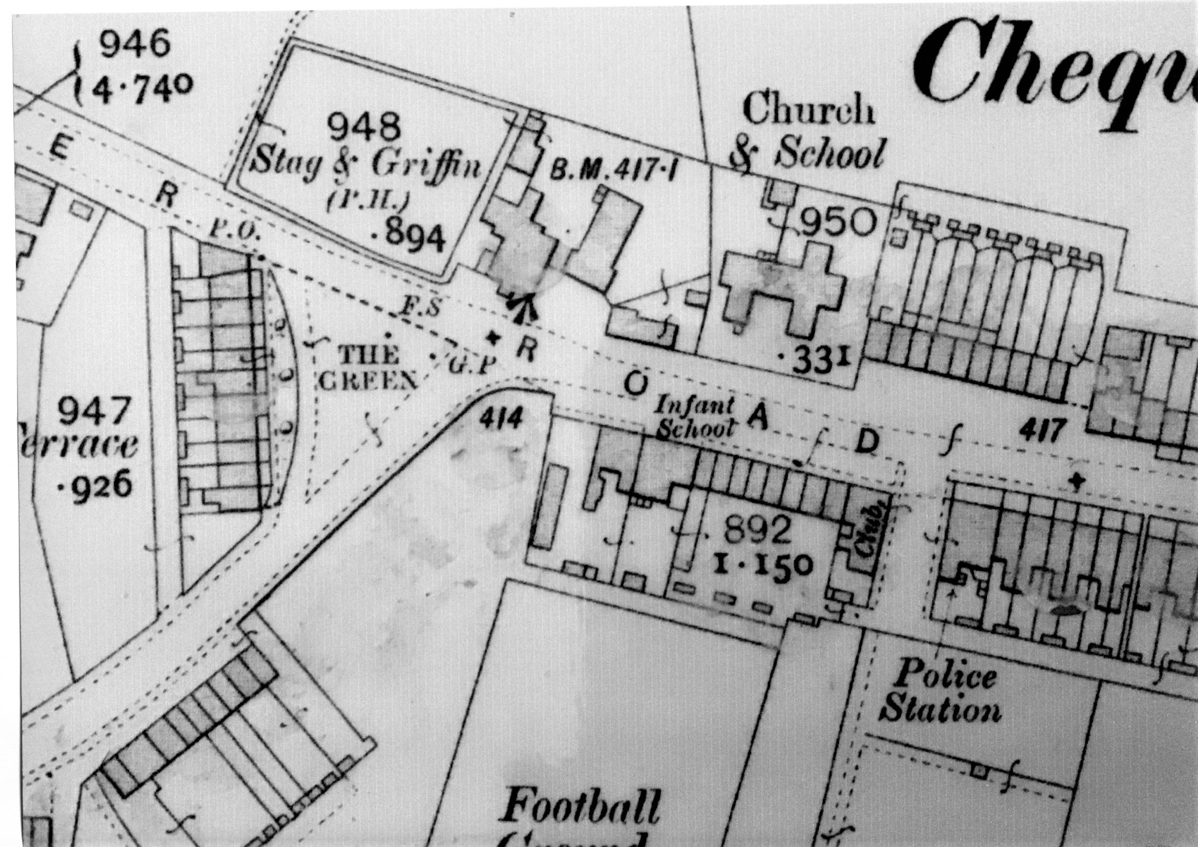
Stag and Griffin pub
Primary School
Maypole Terrace
Manchester Road
Park Road
Police Station

Slide 7
Businesses and establishments listed in the 1902 - 1904 Directory for Westhoughton.
CHEQUERBENT MISSION CHURCH, Park Road, Jas Minion,Curate
CHEQUERBENT RAILWAY STATION (L&NW), Ellis Hope, Stationmaster
CHEQUERBENT SAVINGS BANK & POST OFFICE,268 Manchester Road,E T Smith, Postmaster
HULTON & CHEQUERBENT CO-OPERATIVE SOCIETY LTD 1-3 Brancker Street, Over Hulton
HULTON COLLIERY Manager, Alf J Tonge, Chequerbent
HULTON COLLIERY INSTITUTE 5 Brancker Street, Over Hulton
HULTON PARK ESTATE OFFICE, Manchester Road
OVER HULTON DAY SCHOOL, Sylvester Buckley, Master

Slide 8
Maypole Terrace
Before the Chequerbent primary school was built, children were taught in some rooms of the Maypole Terrace.

Slide 9
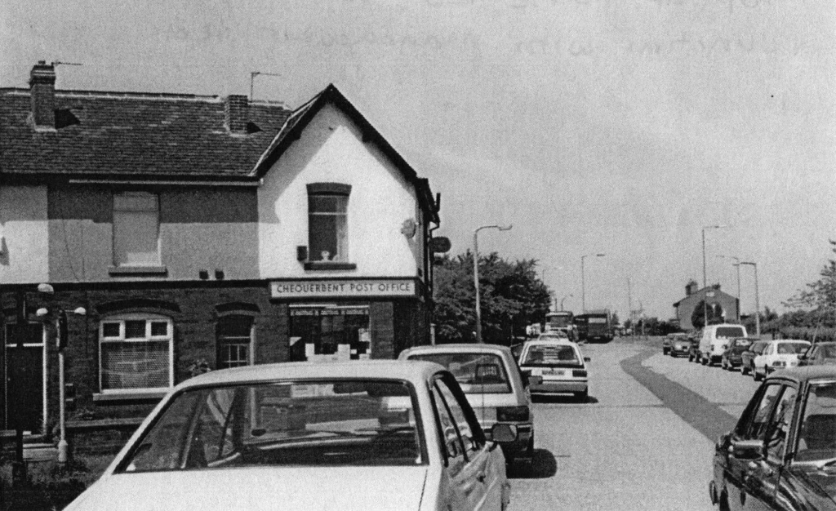

Slide 10
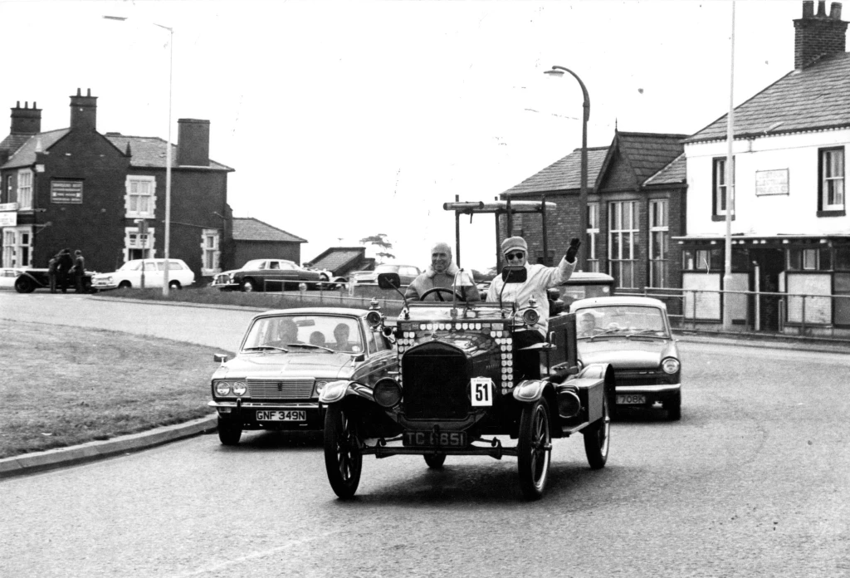

Slide 11
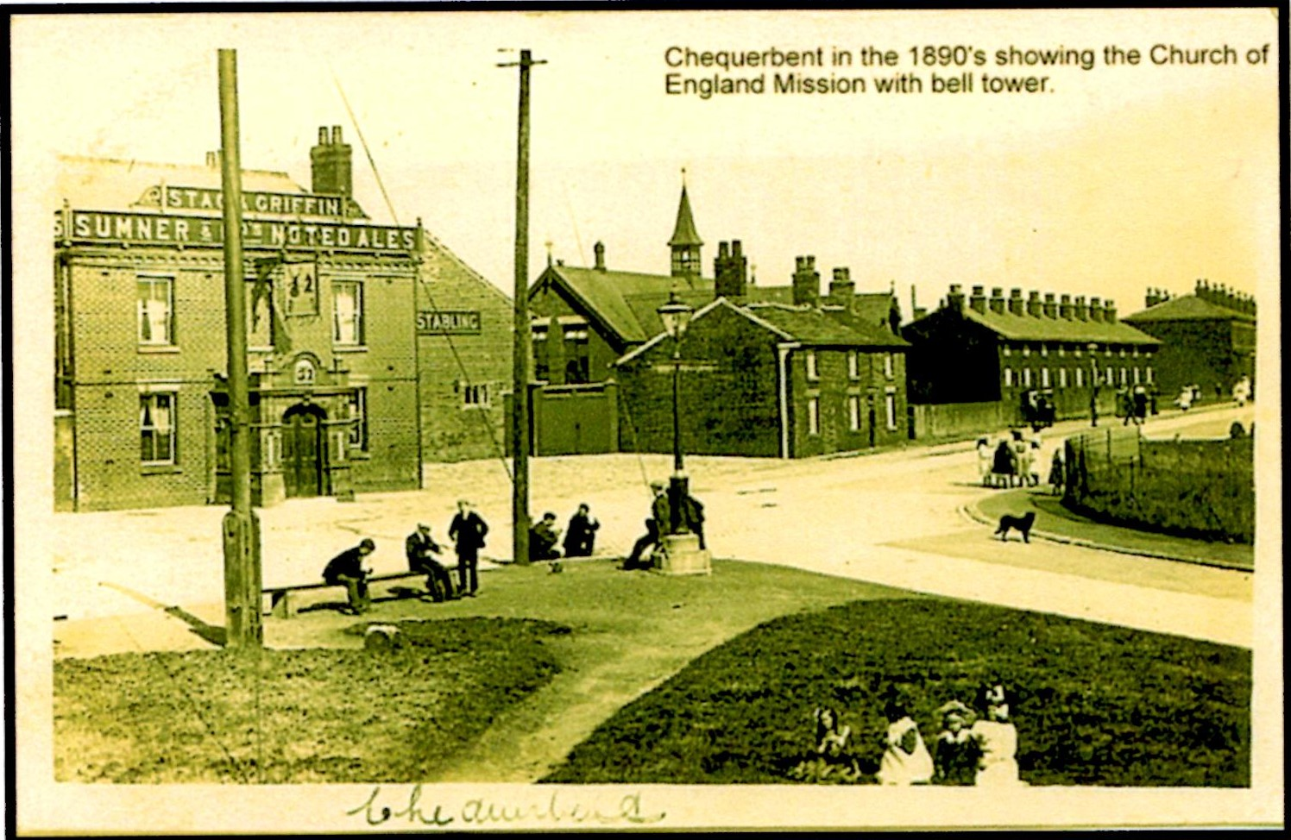
Stag and Griffin Pub

Slide 12
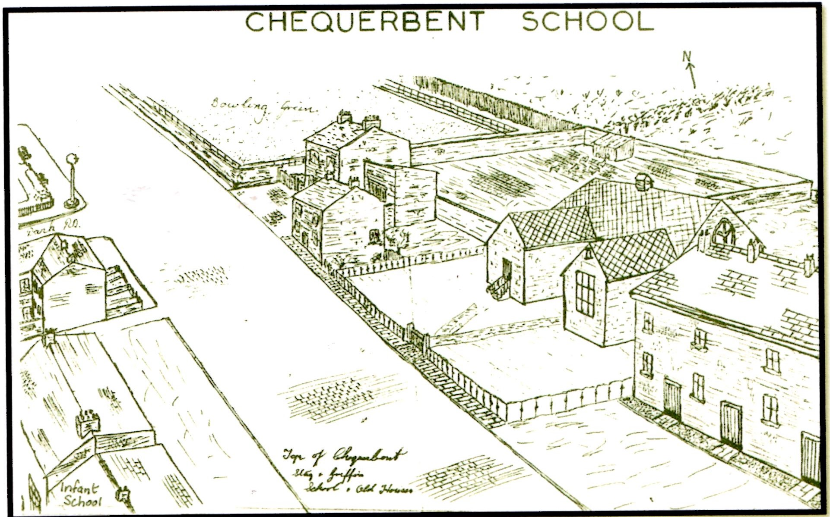
Chequerbent Primary School
Primary School and Mission Hall

Slide 13
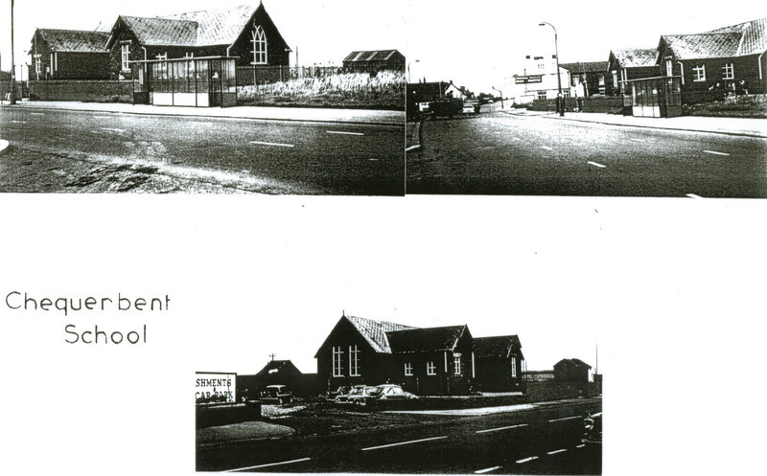
Chequerbent School
The building was opened by Mrs Hulton in 1889 and was used as a Mission School on Sundays and a day school on weekdays.

Slide 14
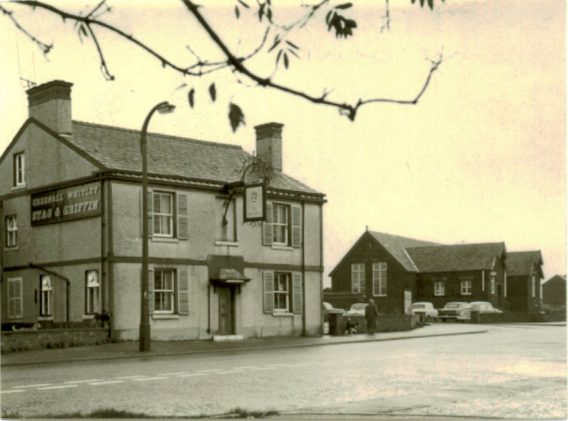
Stag and Griffin and Church

Slide 15
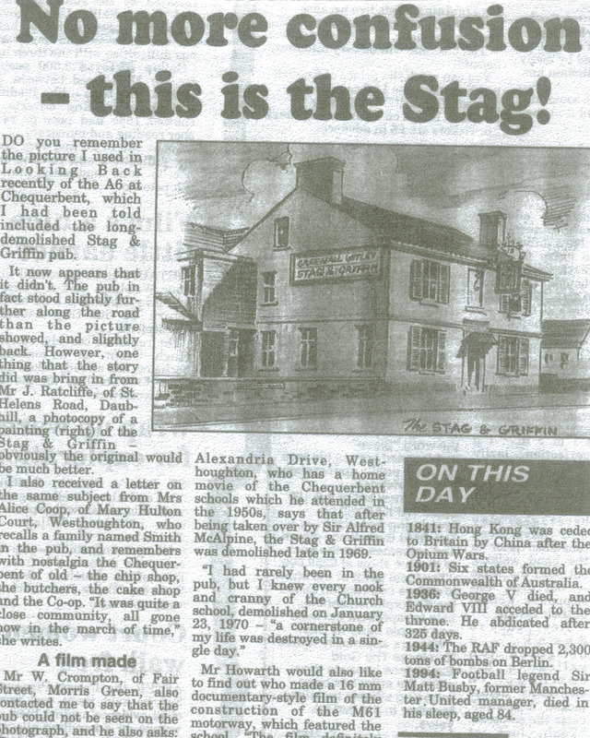

Slide 16
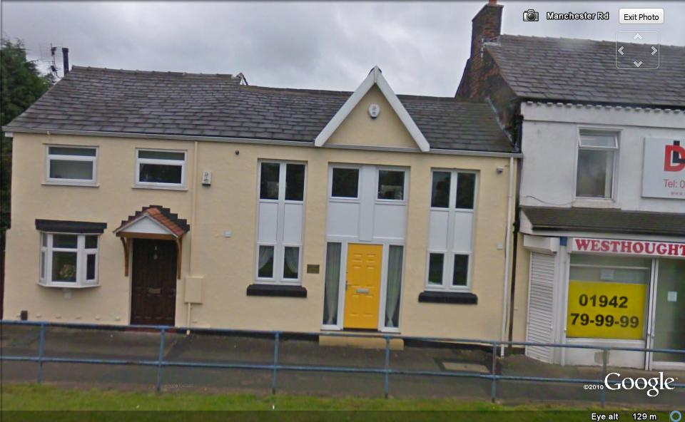
Infant School, Manchester Road

Slide 17
Chequerbent Police Station

Slide 18
MANCHESTER ROAD, CHEQUERBENT. 1902/04 DIRECTORY
BATESON Joshua Engineer 662 Manchester Road
BERRY James Provision dealer 900-902 Manchester Road
BRIGGS James Clogger & Shoemaker 693 Manchester Road
CHADWICK Nathaniel Checkweighman 664 Manchester Road
CHADWICK Wm Book keeper 805 Manchester Road, Over Hulton
CHRISTENSON Carl Joiner 706 Manchester Road
CLOSE Jeremiah Colliery Under Manager 714 Manchester Road
ENNION Thos Carter 855 & 857 Manchester Road
GORE Thos Lic Vict Stag & Griffin, 617 Manchester Road
GREGORY James Salesman 795 Manchester Road
HARWOOD Robert Engineer Hulton Cottage, Wigan Road, Over Hulton
HOPE Ellis Stationmaster 699 Manchester Road
HULTON W W B Hulton Park, Over Hulton
JOHNSON Richard Butcher 655 Manchester Road
LAMBERT James Surface Manager 717 Manchester Road
LEE Wm Fried Fish Dealer 653 Manchester Road
MARSH William Colliery Under Manager 704 Manchester Road
MILLINGTON Jacob Colliery Manager 712 Manchester Road
MINION Rev.James Curate -St Bartholomews 723 Manchester Road
RALPH John Minder 657 Manchester Road
RUSHTON Edward Assistant Colliery Manager Manchester Road
SHAW Jas Blacksmith 905 Manchester Road, Over Hulton
SHONE Samuel Lamp Cleaner 660 Manchester Road
SHUTTLEWORTH Edwin Policeman 895 Manchester Road
SINKINSON Thos Schoolmaster 713 Manchester Road
SMITH Edw Thornley Wholesale & Retail Grocer &c & Post Office 620 Manchester Road
TANNER Alfred Colliery Manager Woodbine House 701 Manchester Road
WILLIAMS John Colliery Manager 708 Manchester Road
WILLIAMS Thomas Under Manager Manchester Road
WILLIAMS Walter Butler Hulton Park, 749 Manchester Road
WOODS Robert Farmer Rungerwall Farm, 811 Manchester Road
WOOLEY Wm Ganger 666 Manchester Road

Slide 19
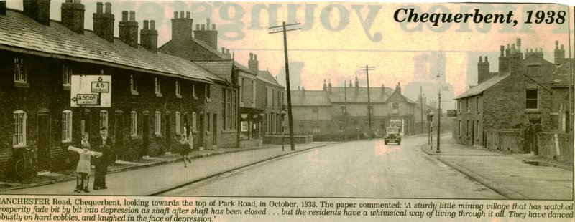

Slide 20
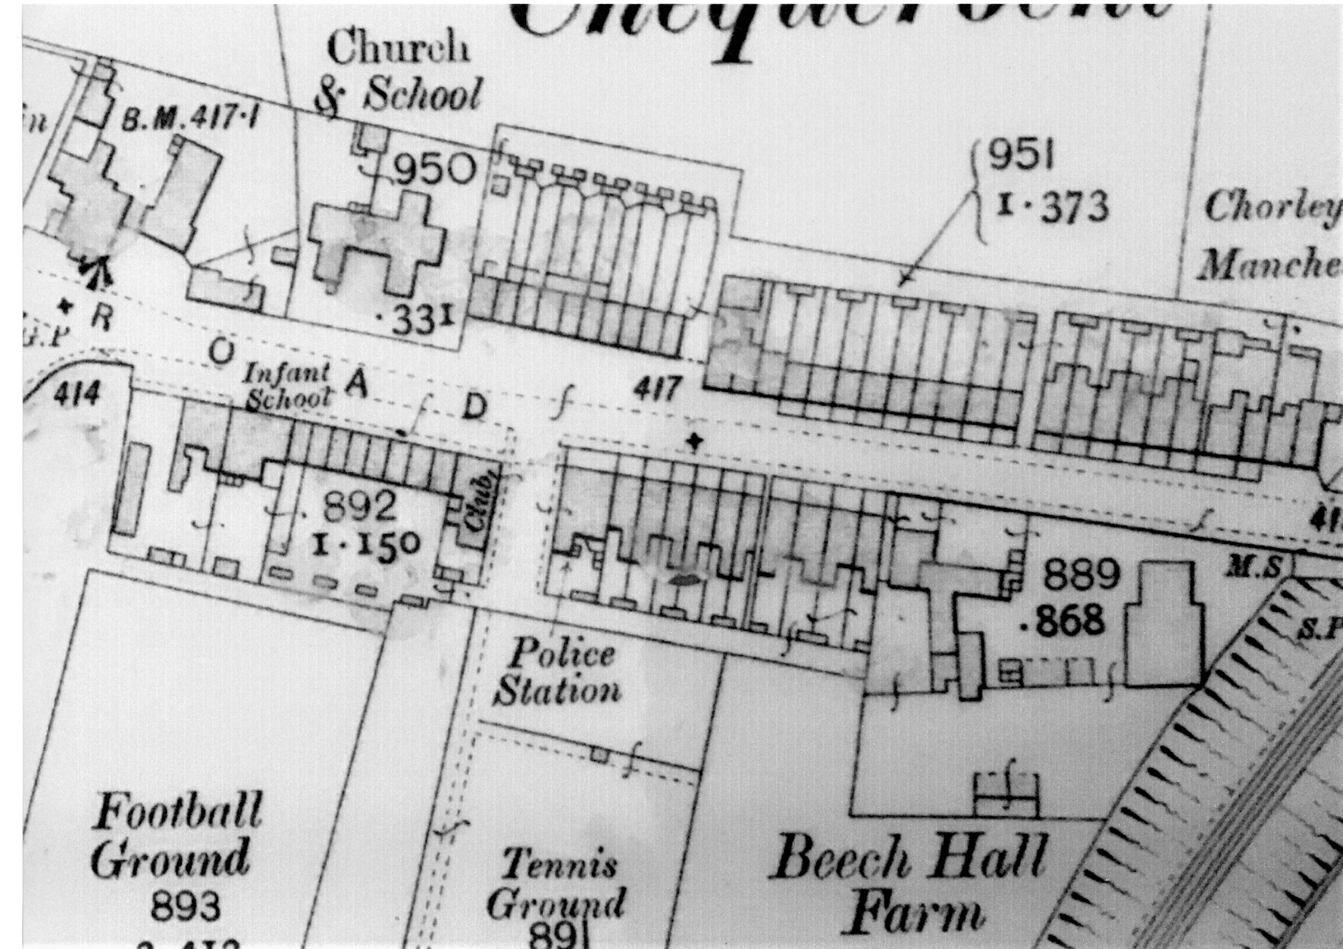

Slide 21
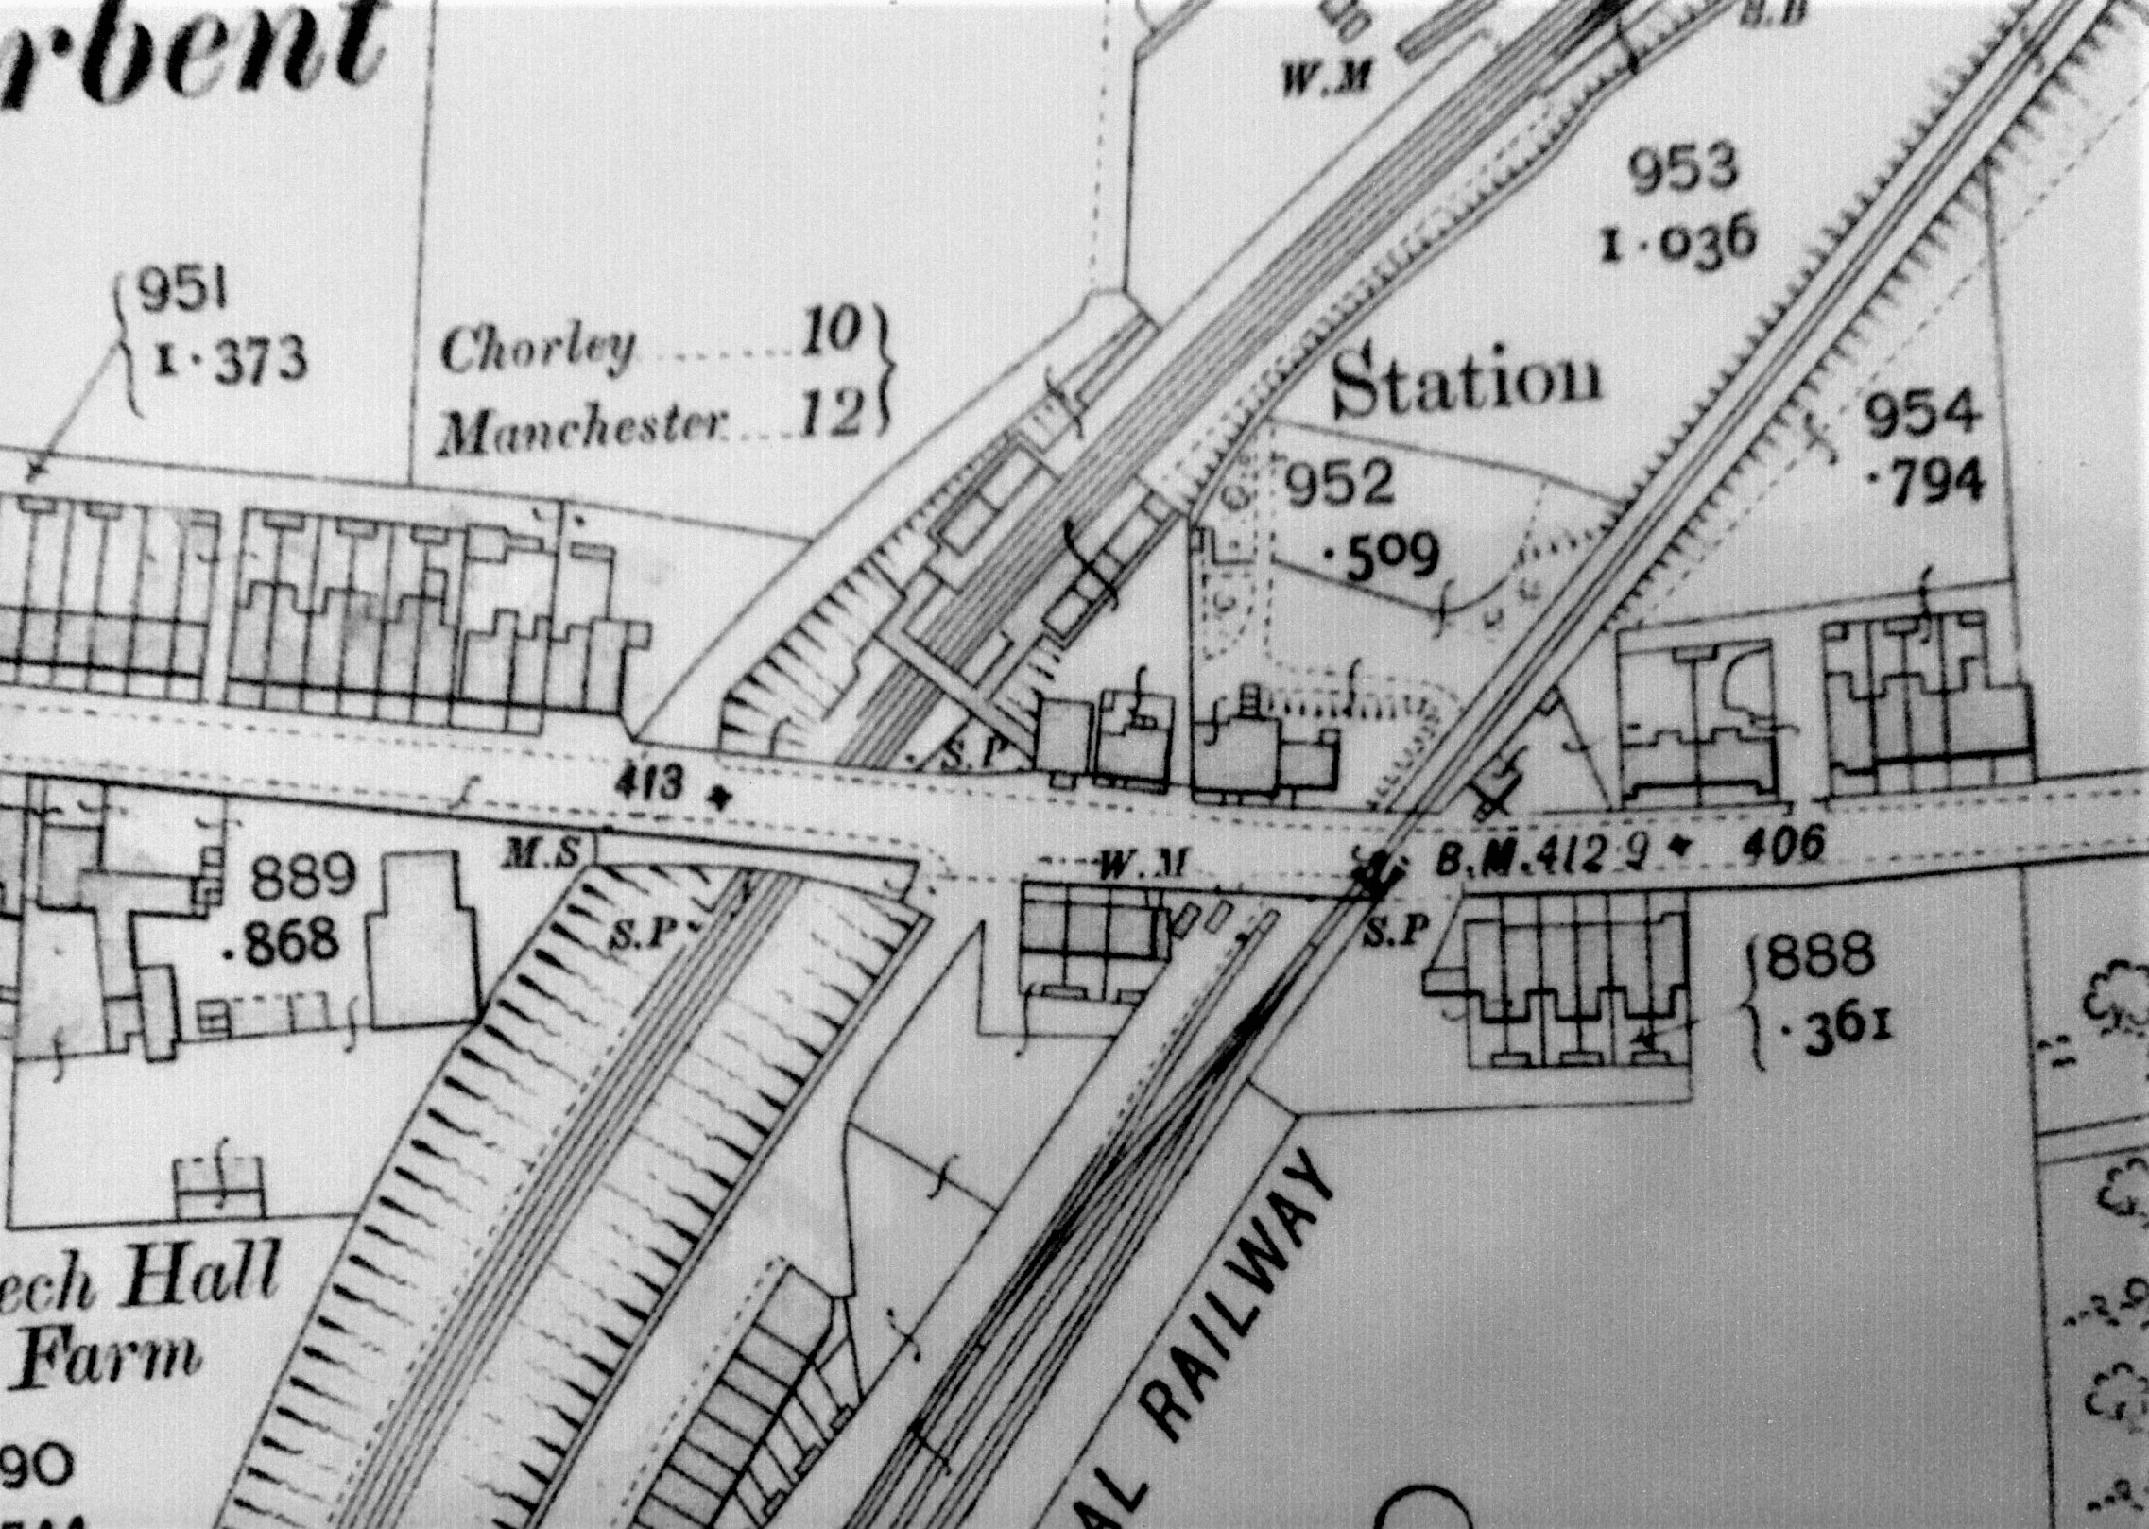
Reconstructed railway line built 1855
Crossing Keeper’s Cottage
Manchester Road
Chequerbent Station
Bolton – Leigh line built 1828

Slide 22
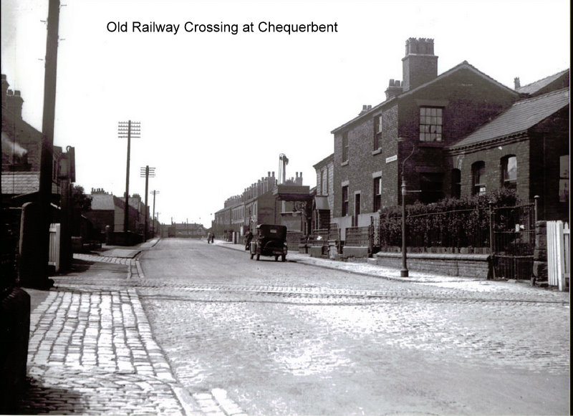

Slide 23
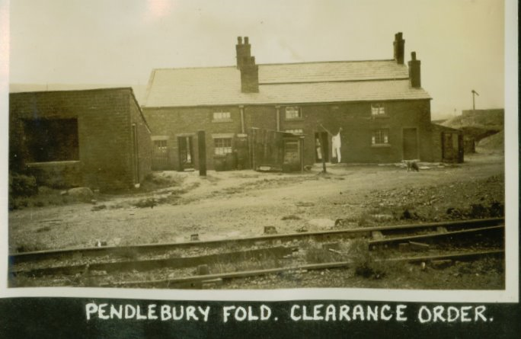
This location is significant because the first train from Chequerbent to Bolton in 1828 in fact started at Pendlebury Fold which was a spur from the main line towards Bolton Road, lower down than Snydle. The Hulton Estate owned the Pendlebury Fold land.

Slide 24
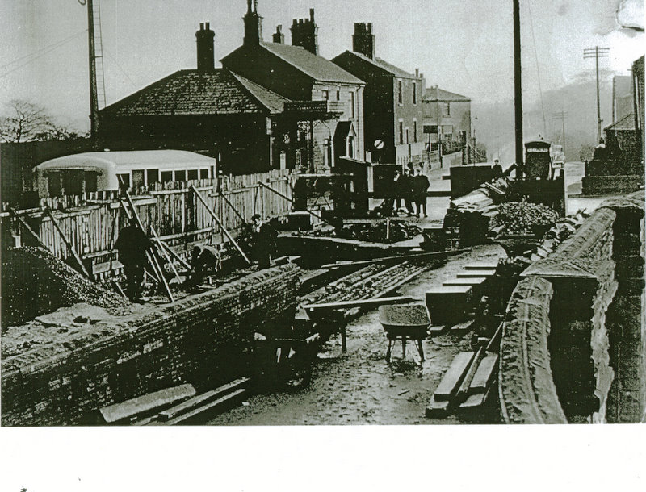
Chequerbent Station

Slide 25
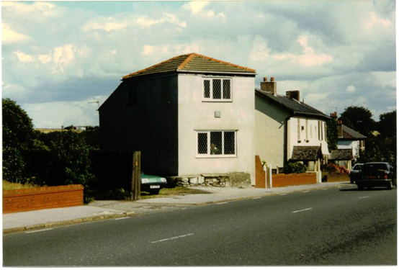
Crossing Keeper’s Cottage / Hope Cottage
The original mineral line crossed the A6 approx. where the green coloured car is parked.

Slide 26
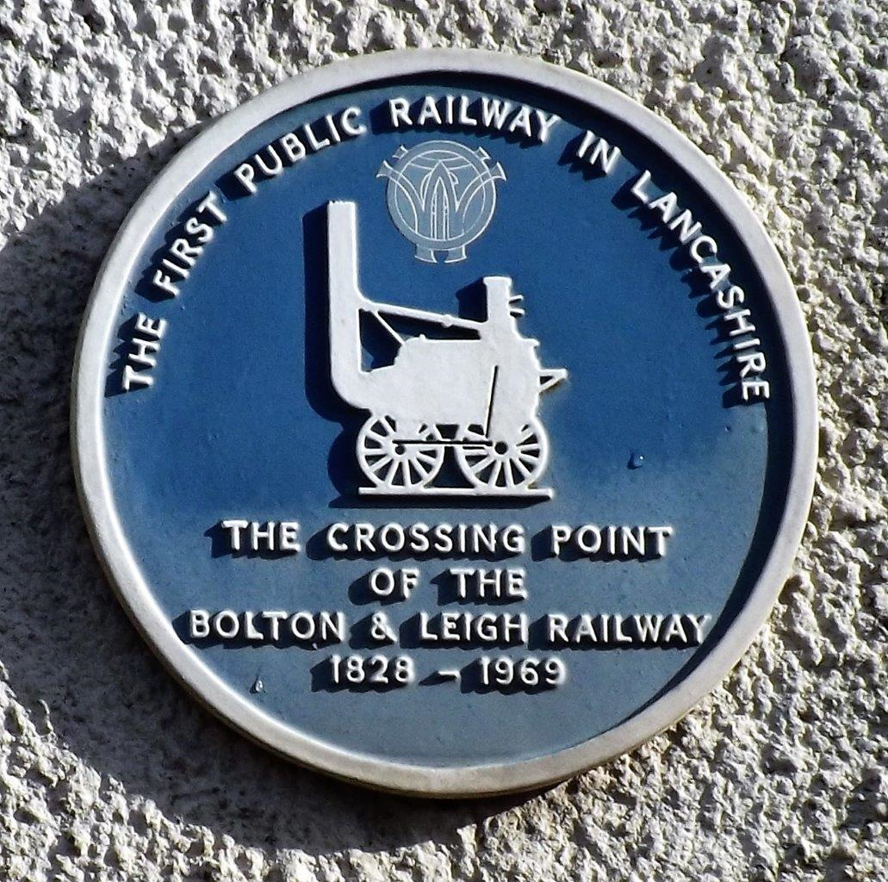
This plaque was installed by the original Westhoughton History Group.

Slide 27
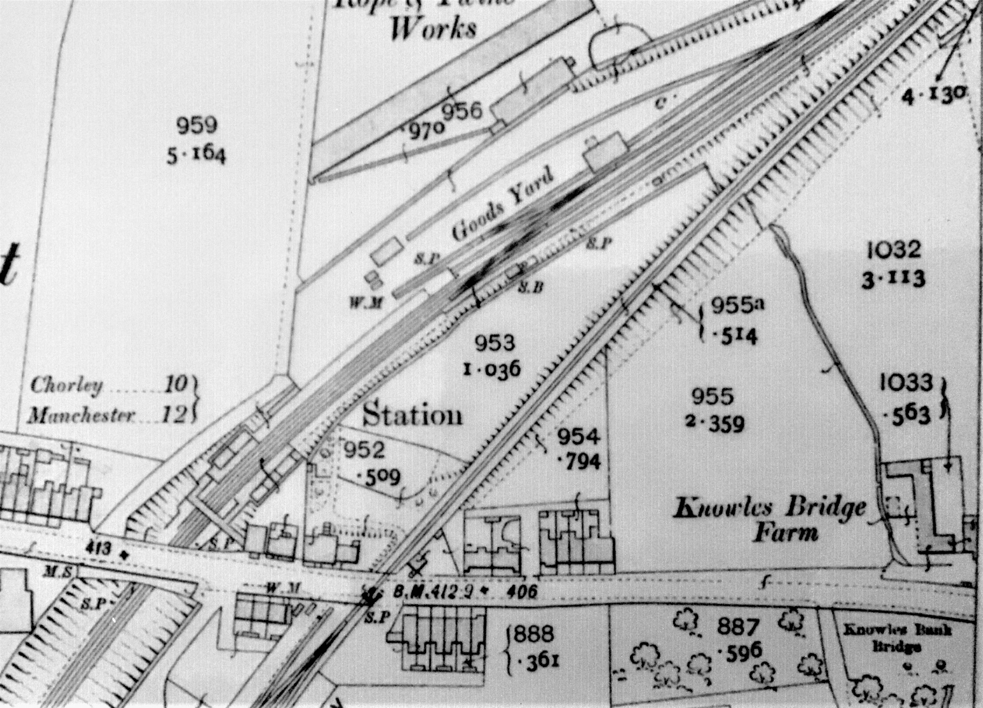
Taylor’s Rope Works
Brancker Street
Dame School
Hulton Park cottage entrance

Slide 28
CHEQUERBENT BANK
The foundations of this historic Bolton & Leigh railway were laid in 1828.
The regular passenger service from Bolton Great Moor Street to Kenyon Junction, which served Atherton Bag Lane Station finished on 29th March 1954, and following the discontinuance of Wakes Weeks specials from Bolton to North Wales after 1959, it became strictly freight only – until January 1969 when the last section north of Howe Bridge was closed.
During the last years the principal traffic was the conveyance of raw materials to a steelworks at Hulton’s Sidings, just north of Chequerbent, which involved a tortuous climb from Atherton, officially at 1 in 30, but even more demanding in places due to colliery subsidence. It was often necessary to split trains at Atherton and take them forward in stages and even then the help of a banker was needed.
This pair of Stanier ‘8F’ 2-8-0s. No 48327 leading and No 48529 at the back, combine forces to lift another heavy load up the taxing incline to Chequerbent from Atherton on 31st May 1968.

Slide 29
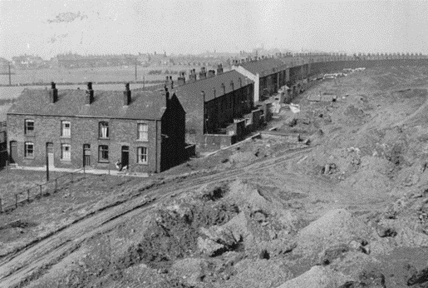
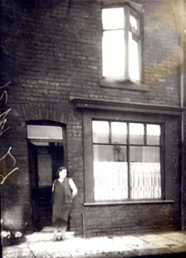
Brancker Street
Brancker Street was named after John and Richard Brancker who were a directors of the Hulton Collieries Company.
The Street was built as housing for miners and was considered to be the longest street in Lancashire.
The street faced the fencing of the Bolton – Leigh railway at the front and at the rear the Hulton Collieries number 1 and 2 pits along with a mineral line and slag heaps!
Number 5 Brancker Street

Slide 30
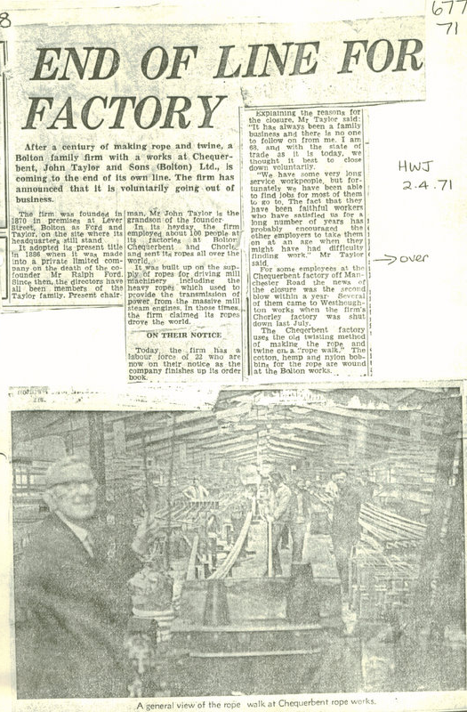
Taylor’s Rope Works

Slide 31
Jose K Holt
Scrap metal merchants
Taylor’s Rope Works
Becolls coach builders

Slide 32
ROPE WORKS AT CHEQUERBENT
(From Horwich & Westhoughton Journal 2nd April 1971)
END OF LINE FOR FACTORY
After a century of making rope and twine, a Bolton family firm with a works at Chequerbent, John Taylor and Sons (Bolton) Ltd., is coming to the end of its own line. The firm has announced that it is voluntarily going out of business.
The firm was founded in 1870 in premises at Lever Street, Bolton as Ford and Taylor, on the site where its headquarters still stand.
It adopted its present title in 1886 when it was made into a private limited company on the death of the co-founder Mr Ralph Ford. Since then, the directors have all been members of the Taylor family. Present chairman, Mr John Taylor is the grandson of the founder.
In its heyday, the firm employed about 100 people at its factories at Bolton, Chequerbent and Chorley, and sent its ropes all over the world.
It was built up on the supply of ropes for driving mill machinery including the heavy ropes which used to provide the transmission of power for the massive mill steam engines. In those time the firm claimed its ropes drove the world.
ON THEIR NOTICE
Today, the firm has a labour force of 22 who are now on their notice as the company finishes up its order book.
Explaining the reasons for the closure, Mr Taylor said: “It has always been a family business, and there is no one to follow on from me. I am 68, and with the state of trade as it is today, we thought it best to close down voluntarily.
“We have some very long service workpeople, but fortunately we have been able to find jobs for most of them to go to. The fact that they have been faithful workers who have satisfied us for a long number of years has probably encouraged the other employers to take them on at an age when they might have had difficulty finding work.
For some employees at the Chequerbent factory off Manchester Road, the news of the closure was the second blow within a year. Several of them came to Westhoughton works when the firm’s Chorley factory was shut down last July.
The Chequerbent factory uses the old twisting method of making the rope and twine on a “rope walk.” The cotton, hemp and nylon bobbins for the rope are wound at the Bolton works.

Slide 33
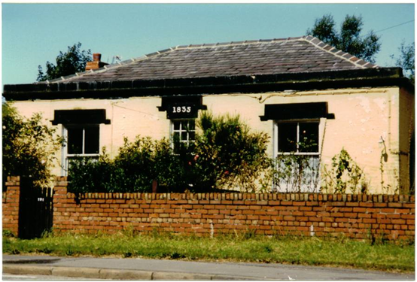
Dame School – Manchester road, opened to educate the children of colliers who worked for Hulton Collieries.

Slide 34
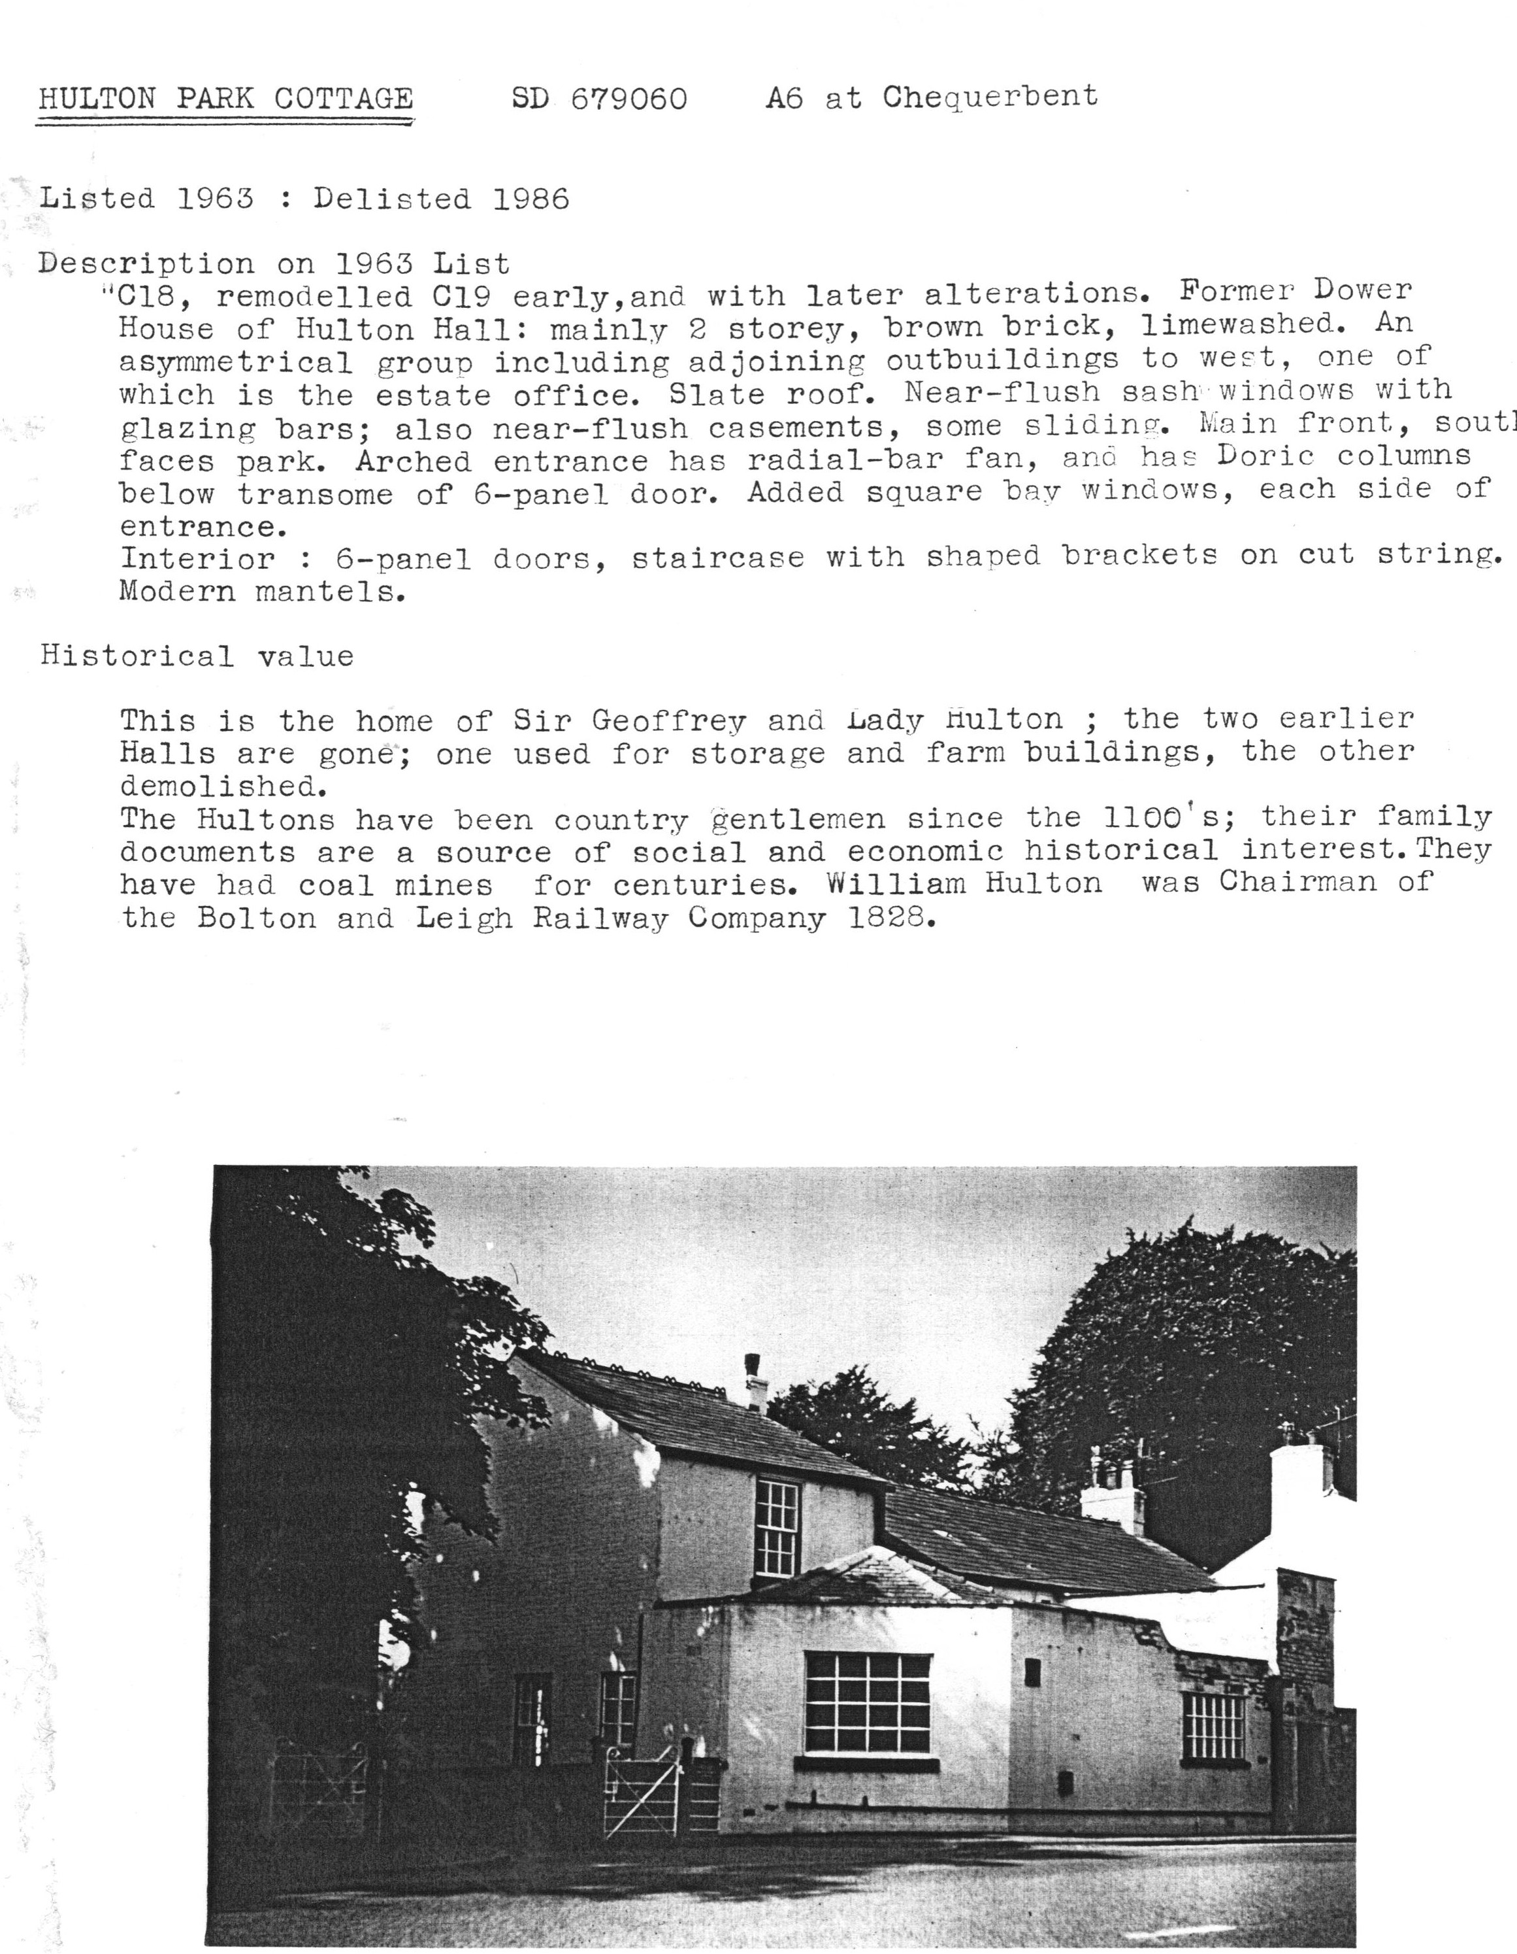
Hulton Park Cottage

