Slide 1
The History of Hart Common
Garth Ratcliffe based on information provided by Pam Clarke

Slide 2
Origin of the name Hart Common
Hart Common extends from Jack’s Lane ( towards Hindley) to Cunningham Brook (near Dobb Brow)
There are two views about this origin :
Being located next to Hindley ( where the female deer was found ) and so Hart , the male deer was adjacent.
The second explanation is that a well established family named Hart had lived in the area.

Slide 3
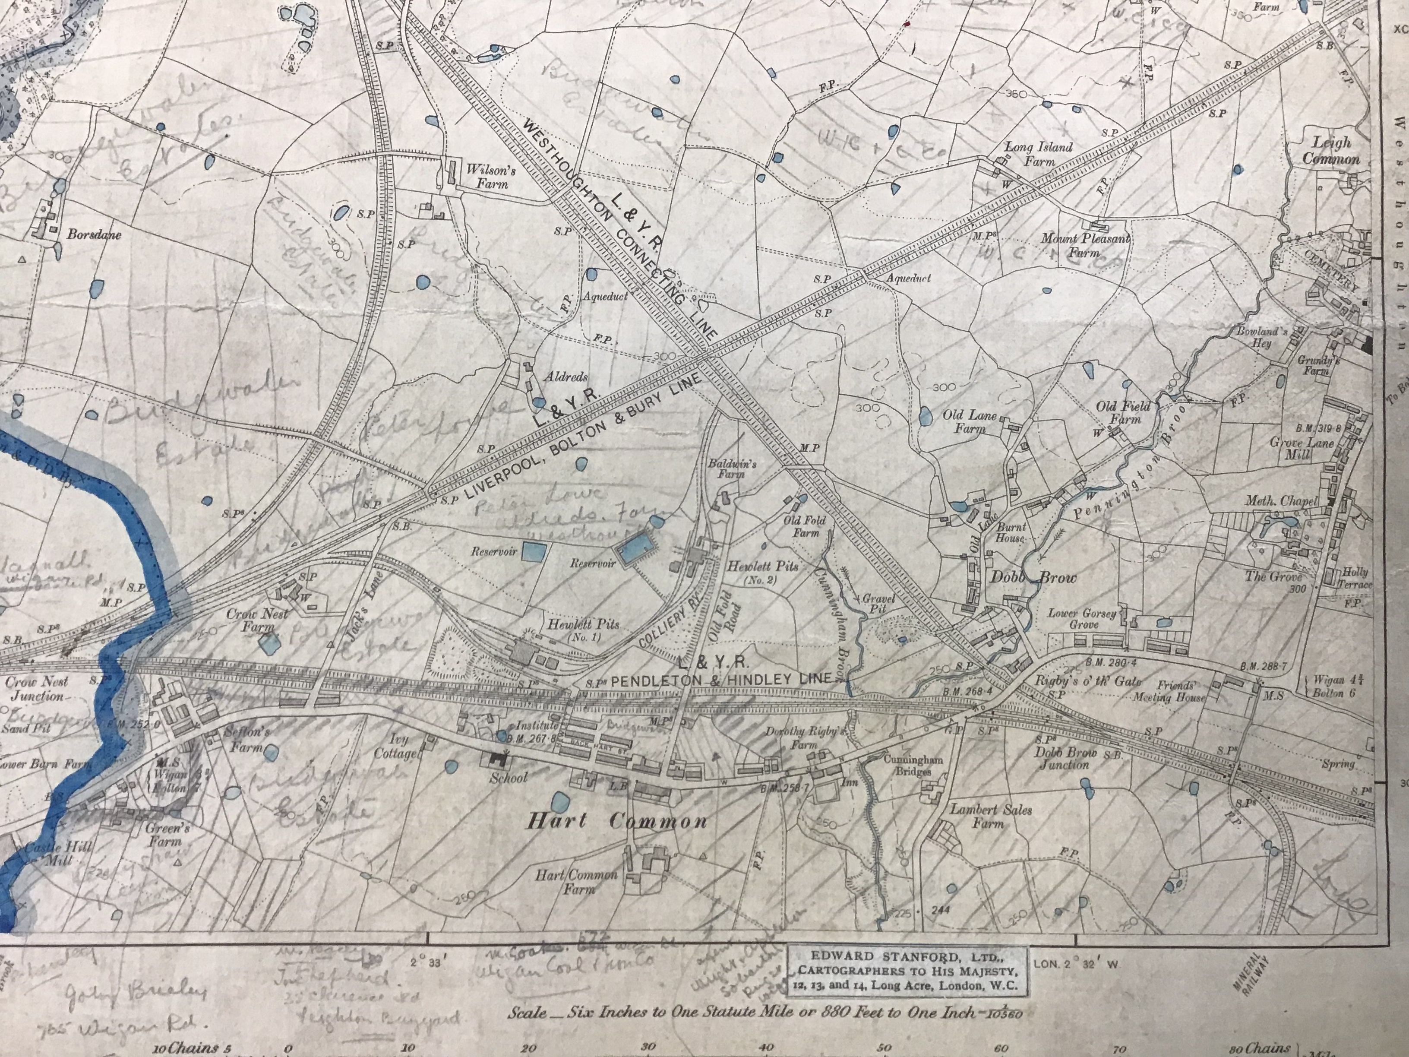
Map of Hart Common

Slide 4
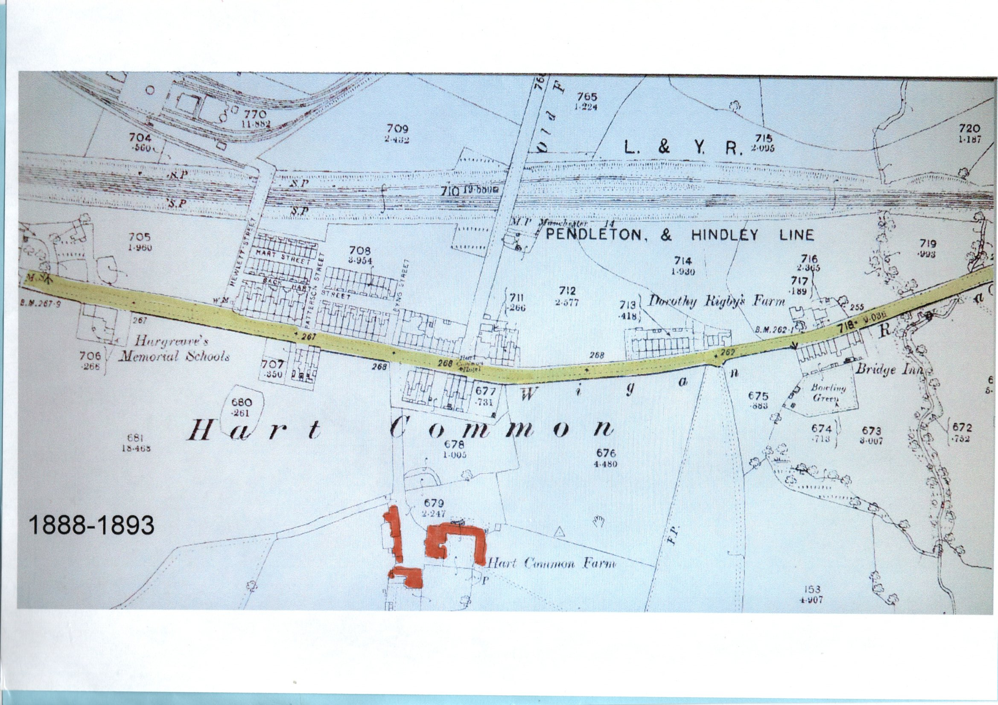

Slide 5
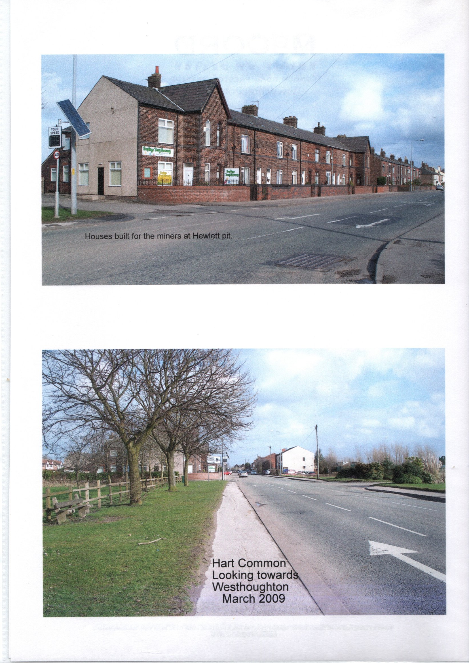

Slide 6
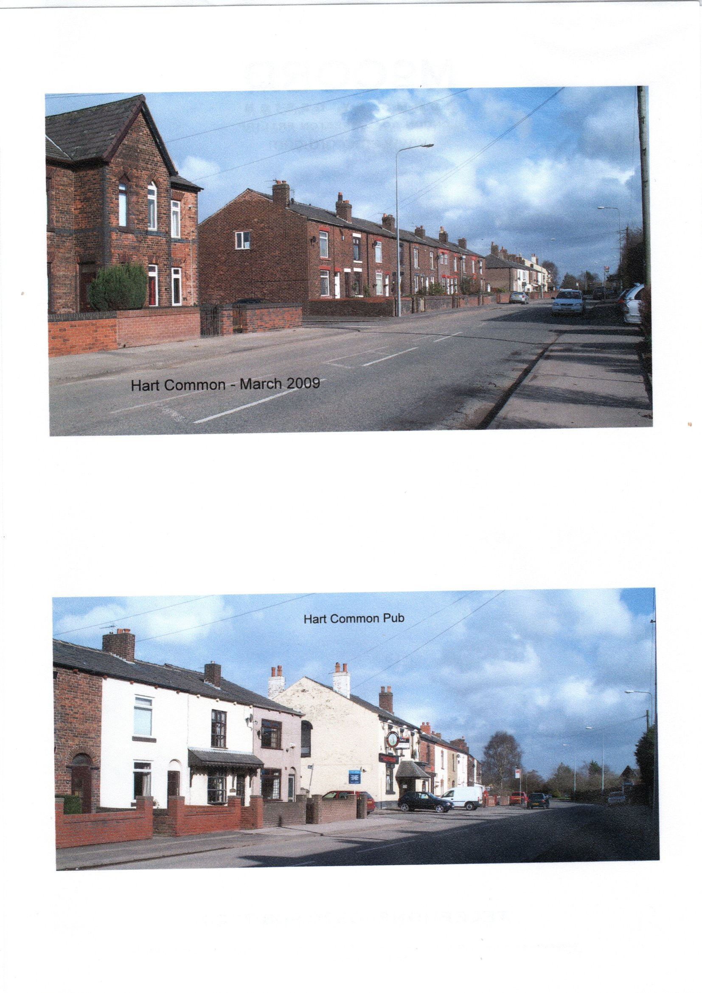

Slide 7
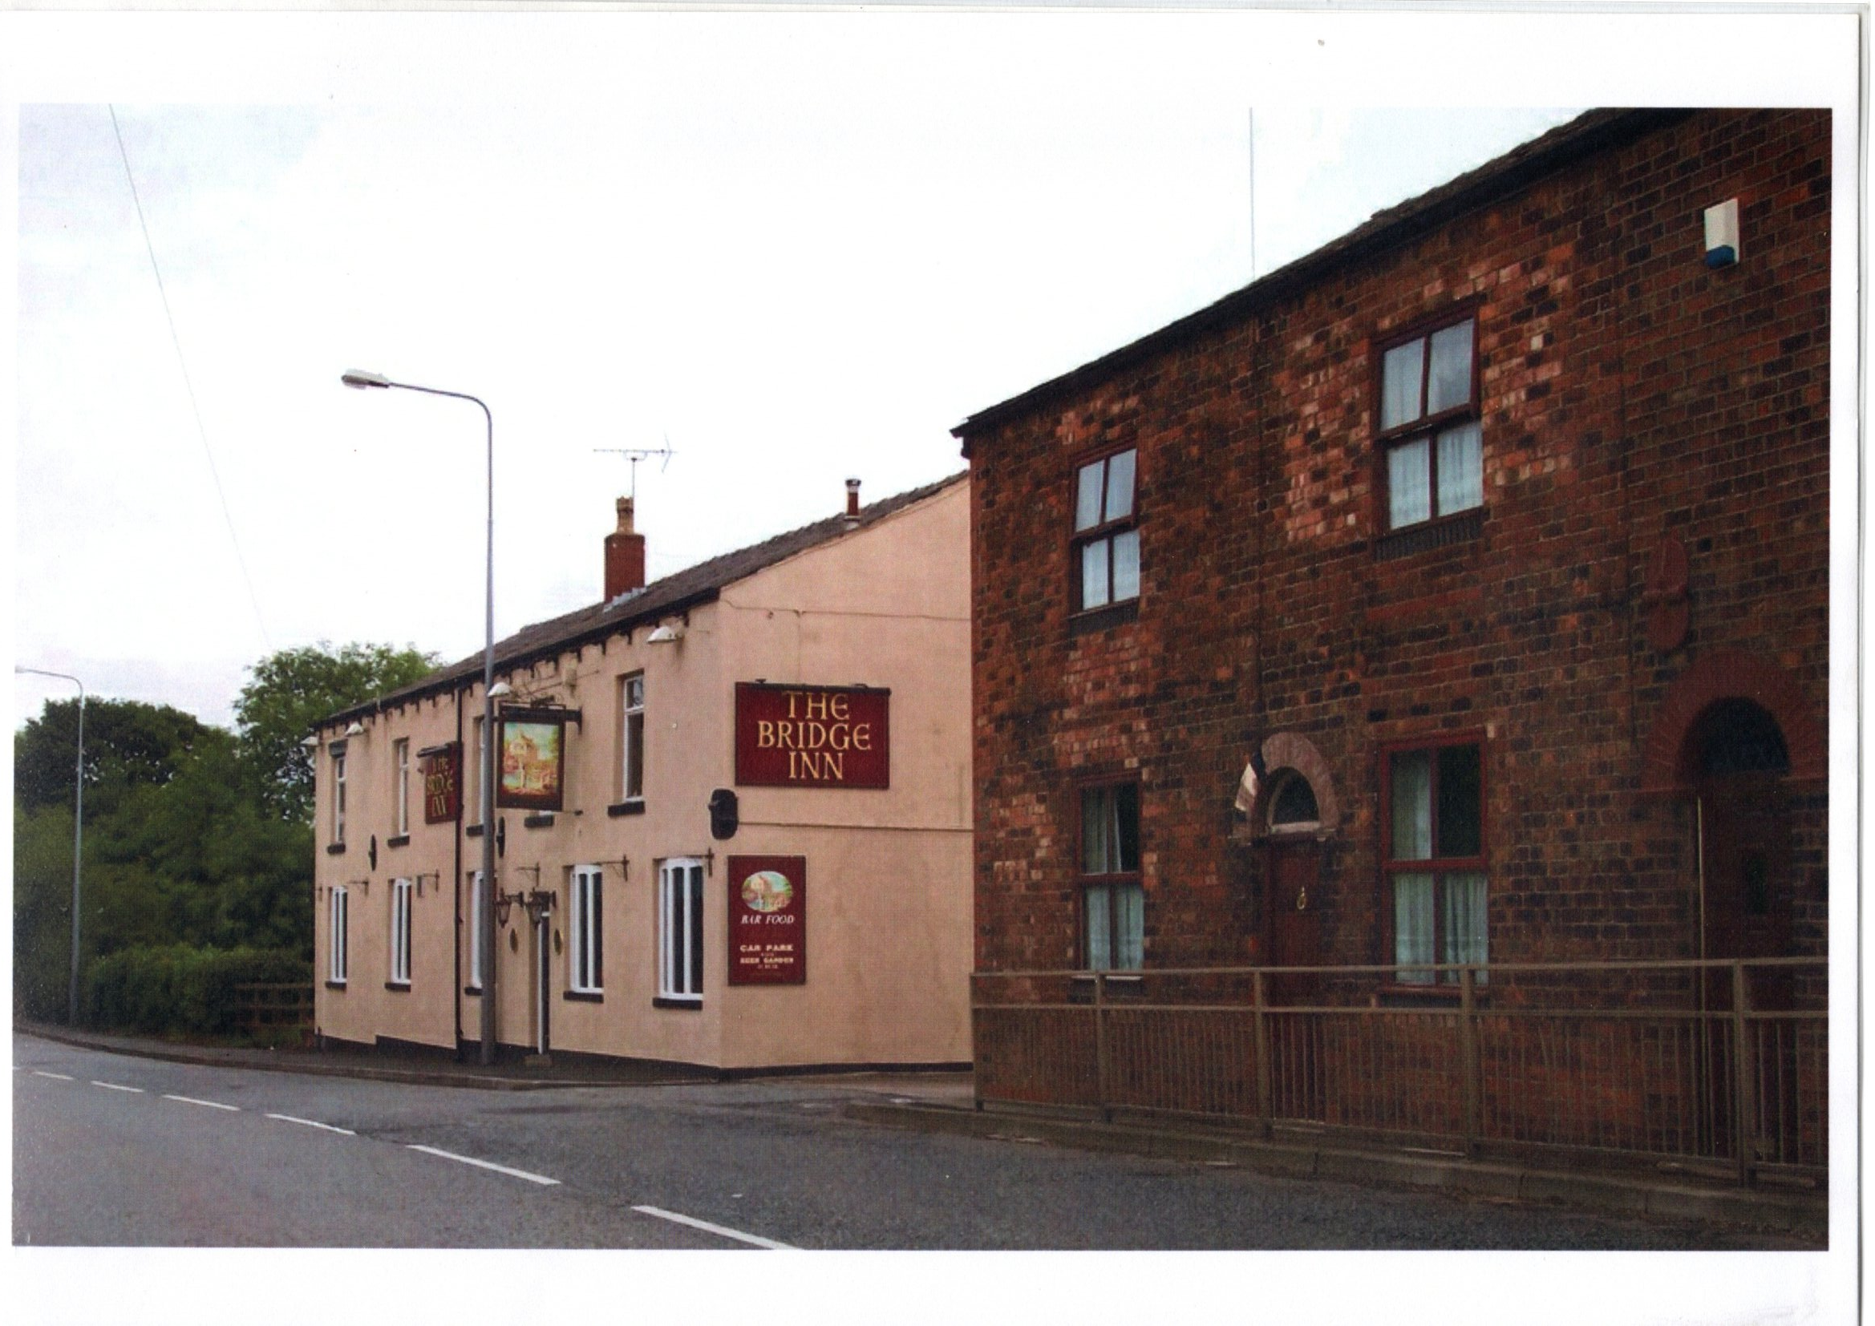
The Bridge Inn

Slide 8
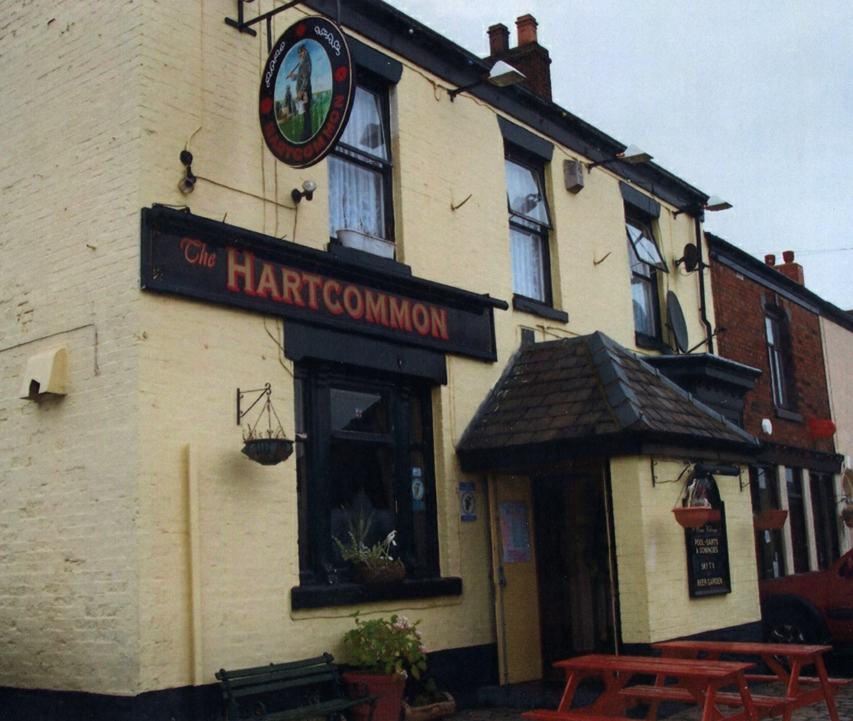
The Hart Common Pub

Slide 9
The Hargreaves Family
James Hargreaves came for Blackburn to Westhoughton in 1736 to expand his father’s successful carrying trade. He leased Hart Common farm from the Duke of Bridgewater.
By 1750 James had established a warehouse at nearby Warehouse Lane, now known as Wearish Lane.
Packhorses were the only means of transport along rough unmade roads.
James died in 1768 and his son John ran the business.
In 1725 the first turnpike road in Lancashire was established and others soon followed and these roads were fit to have large horse drawn waggons on them.
By 1981 canals were being constructed and John Hargreaves built barges to transport goods to Liverpool and Leeds.
John Hargreaves died in 1795.

Slide 10
The next John Hargreaves
Married Tabitha Duckett in 1800 and they produced 13 children all brought up at Hart Common farm.
The eldest John Jnr married May Hick, the daughter of Benjamin Hick, Ironfounder and proprietor of the Soho Ironworks of Bolton.
By 1851 he had become a County Magistrate and proprietor of coal mines.
They went to live in Berkshire and when he died in 1874 he left £600,000!!
1824 John Snr and John Jnr started their railway operations by contracting to lease and operate the Bolton – Leigh Railway.

Slide 11
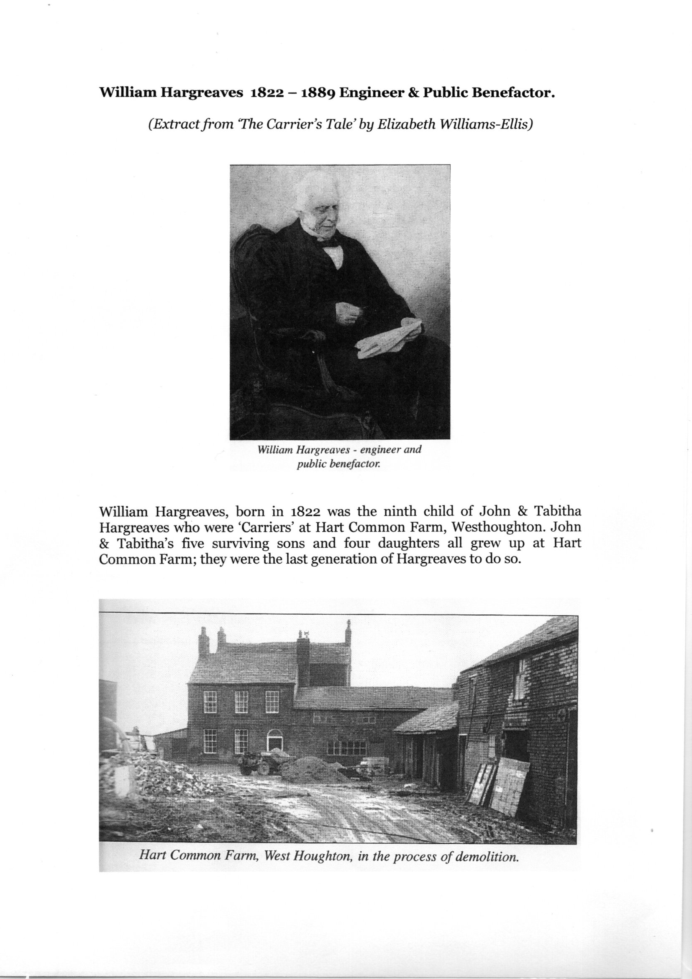
William Hargreaves
William Hargreaves, born in 1822 was the 9th child of John and Tabitha Hargreaves.
William broke with traditional family trade and launched into a career in engineering and had his own business at the age of 16!
John Jnr and his brother in law John Hick became partners in Hick and Rothwell and shortly after William aged 24 and a practising engineer joined the firm.
William and John Hick turned the Soho iron works into a business of national importance.
High quality steel was produced by the factory in the centre of Bolton.
William died in 1889 and the company was taken over by Henry Bessemer and Co.

Slide 12
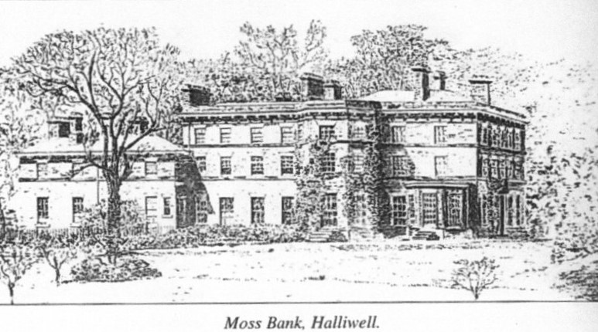
William Hargreaves
In 1858 William, as the family became more prosperous, moved to Darley Hall, Farnworth.
Then in 1873 moved to a large palatial house at Moss Bank, Halliwell which had extensive facilities.
William died at Moss Bank in 1889 and left £586,975.
In 1928 Moss Bank House was pulled down but the spacious gardens and grounds remain as a public park.

Slide 13
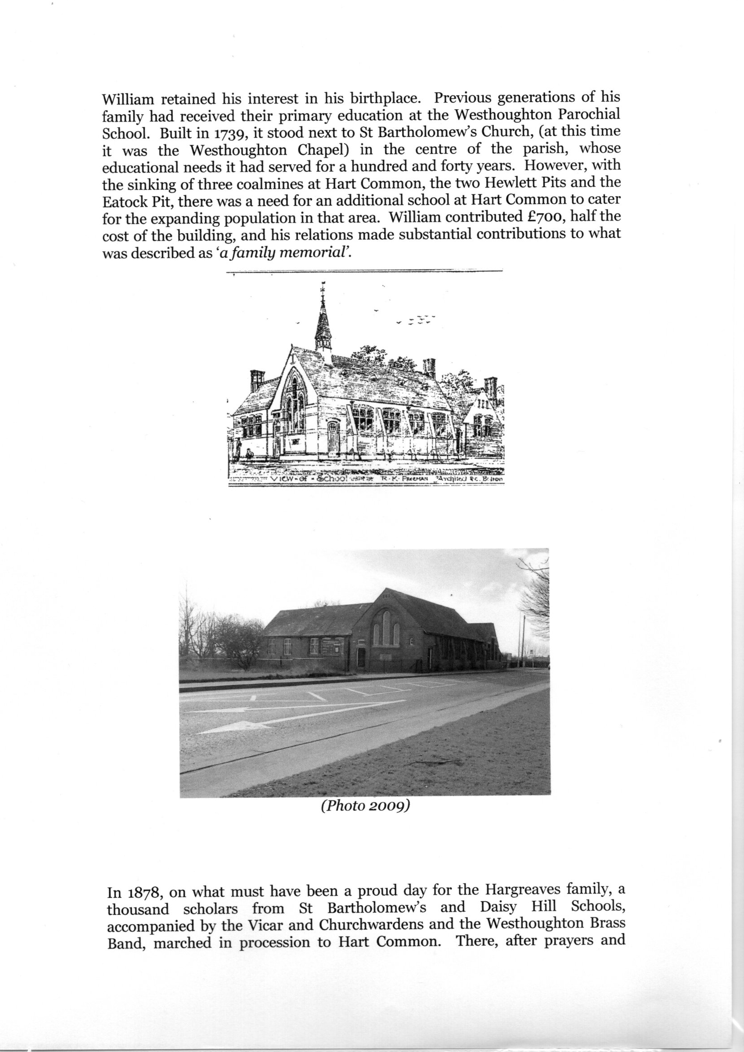
Hart Common School
William Hargreaves provided half the cost of building the Hart Common school in 1878.
There was a demand for a day school and Sunday school because of the opening of the two Hewlett pits and Eatock pit and new families moving into the area.

Slide 14
Hewlett Pits
Named after Alfred Hewlett, mine owner and one of the founder members of the Wigan Coal and Iron Company consortium.
In the 1870’s the Hewlett Pits were sunk by the Wigan Coal and Iron Company and many of the men in the district found work in the mines.
There was a shortage of labour at the pit and many of the irish Harvesters instead of going home after the harvest found work at the pits.
This was during the Franco-Prussian war of the 1870’s and the miners were able to earn £1 per day.
However when the war ended, the price of coal had fallen to 6 shillings a ton and Mr Hewlett called for drastic reductions in their wages.
These were strenuously opposed by the miners and a strike ensued.

Slide 15
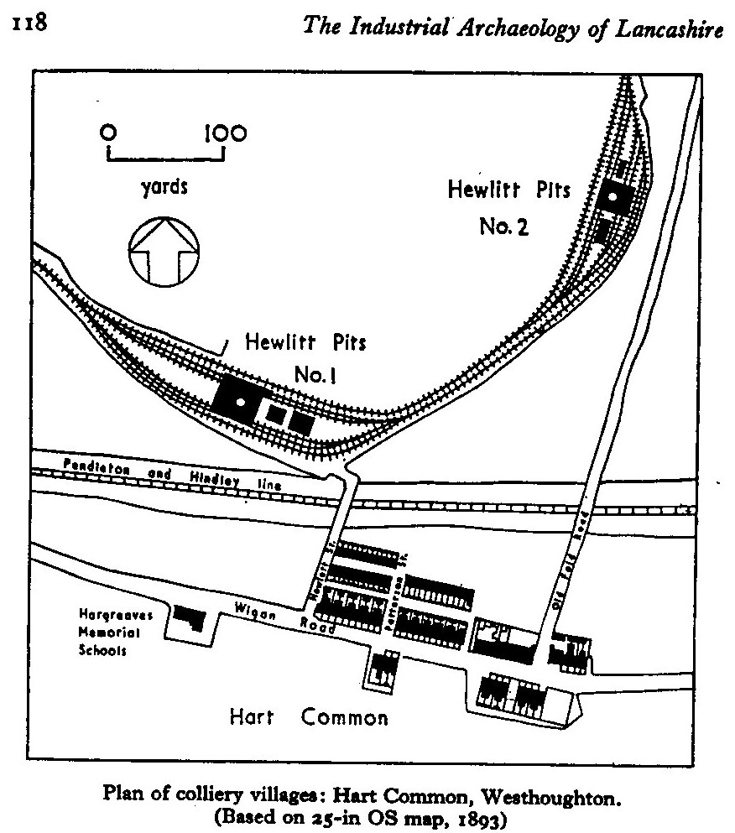

Slide 16
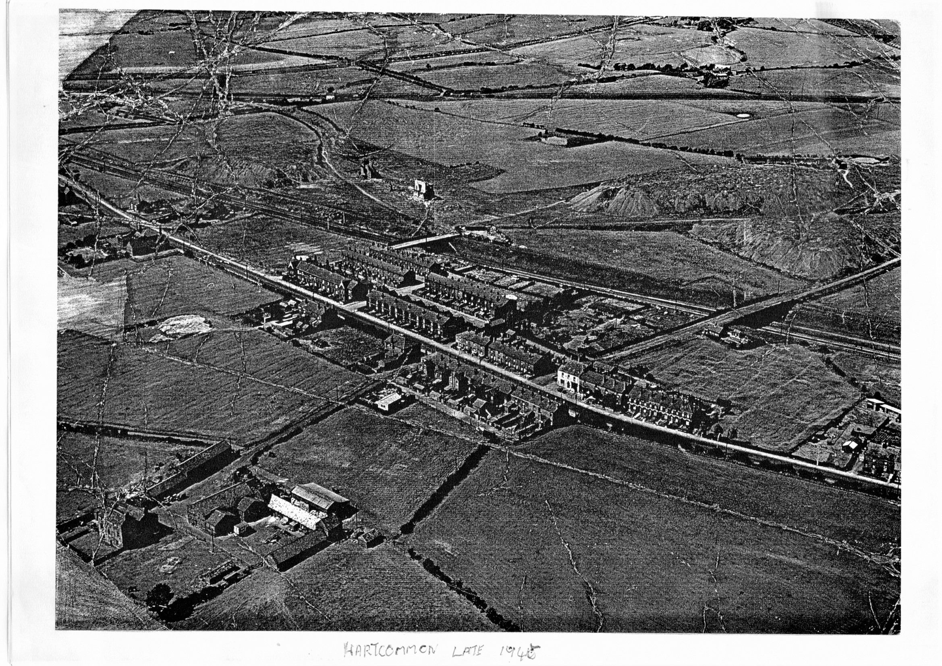
Note the Hewlett Pit slag heaps at the top right of the photo and Hart Common Farm at the bottom left of photo.

Slide 17
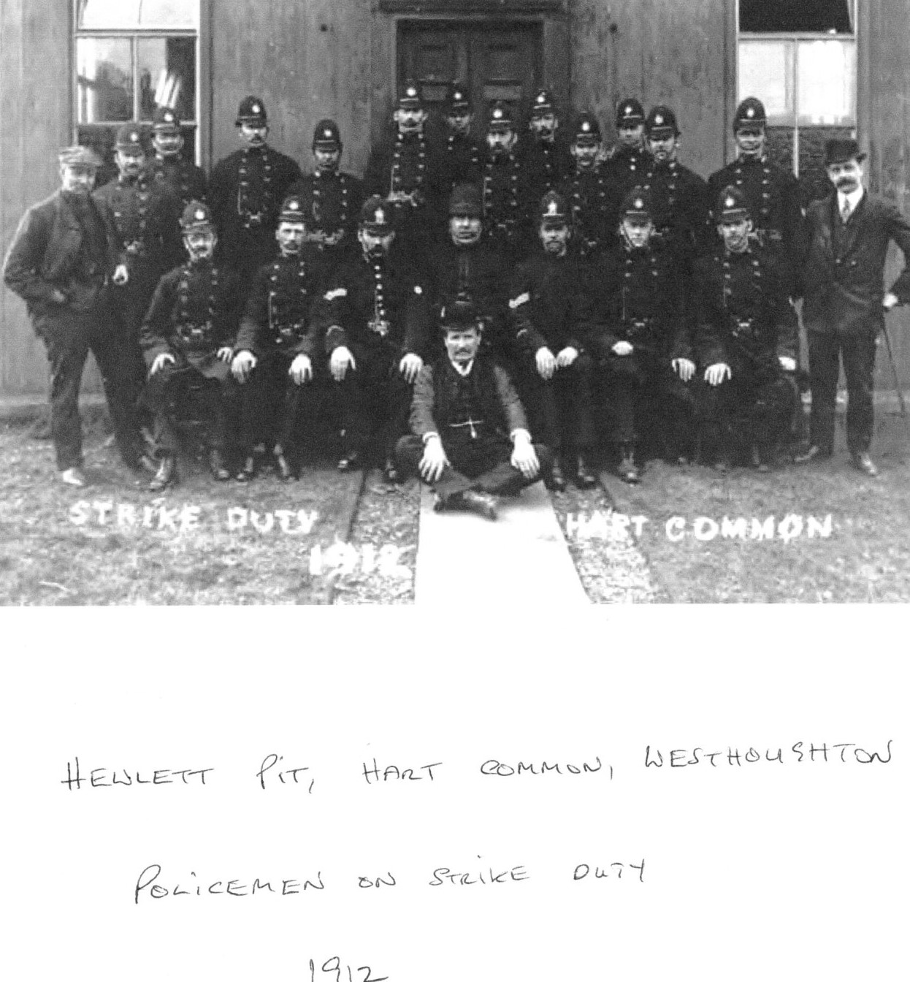
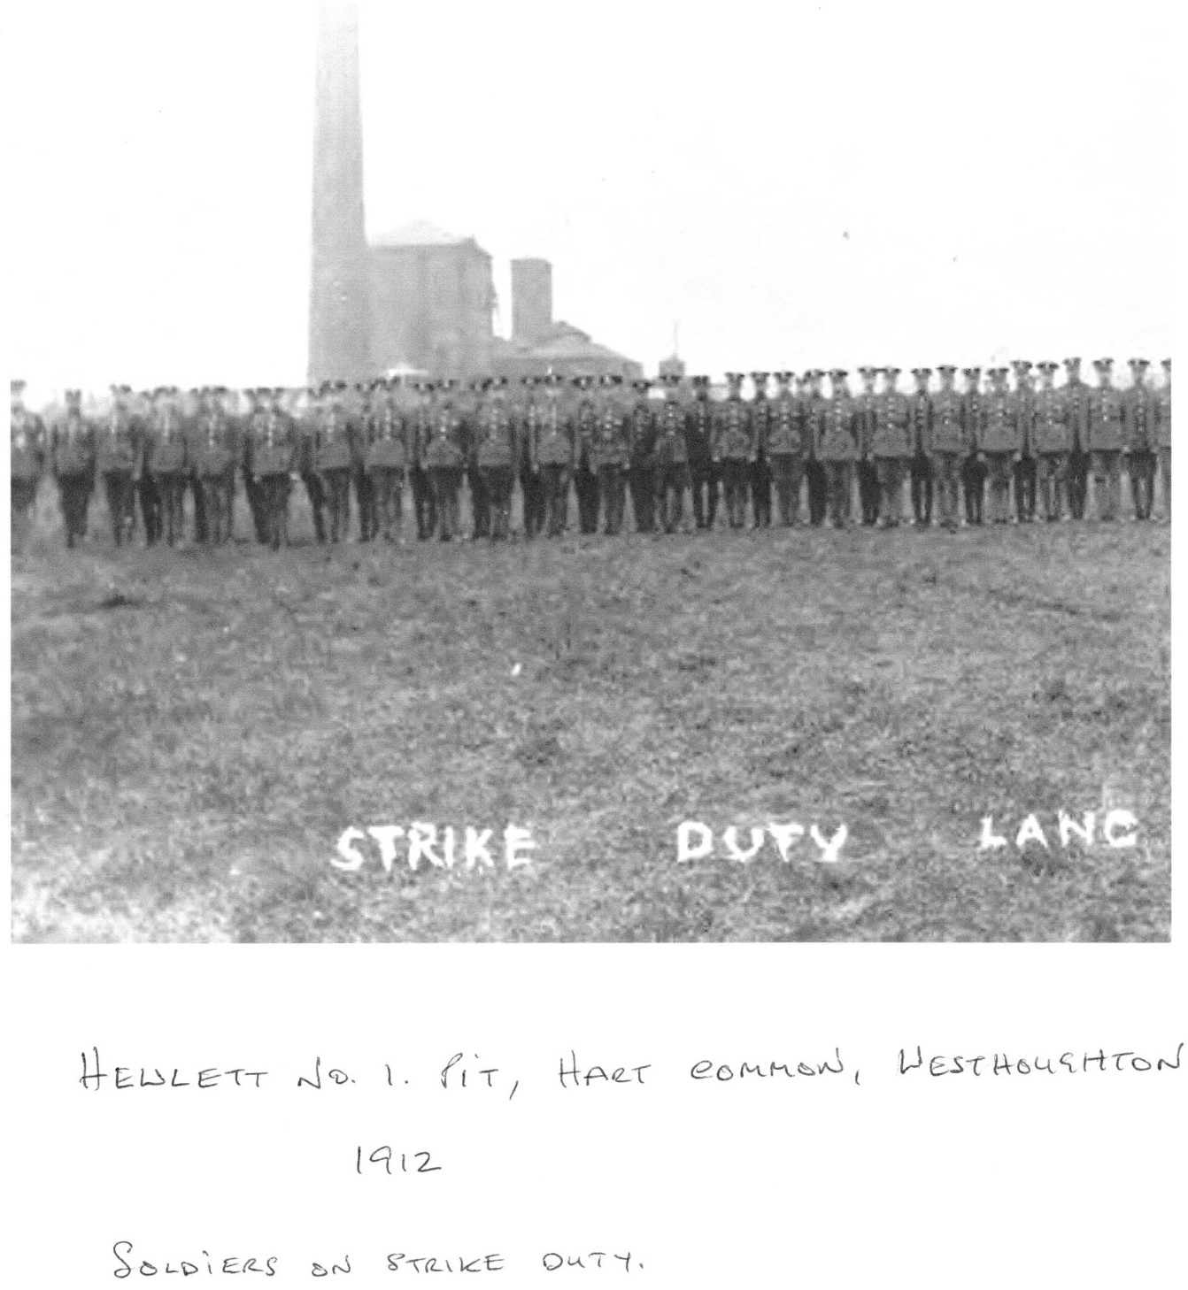

Slide 18
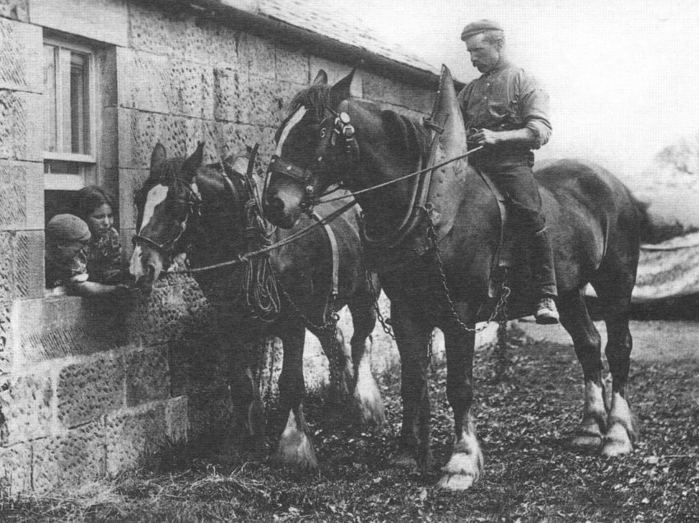
Walker Family of Hart Common Farm
Jim Walker, born 1914, was noted for breeding large shire horses used for ploughing and other farm work.
He was a descendant of Robert Walker one of three brothers who walked from Scotland to seek their fortune.
They certainly achieved that.
Peter Walker went to Warrington and started Walkers Brewery.
William settled in Bolton and started Walkers Tannery
Jim Walker retired in 1979 and died the following year and the farm became tenanted by Peter Roberts in the early 1980’s. The farm is now the site of Hart Common golf club.

Slide 19
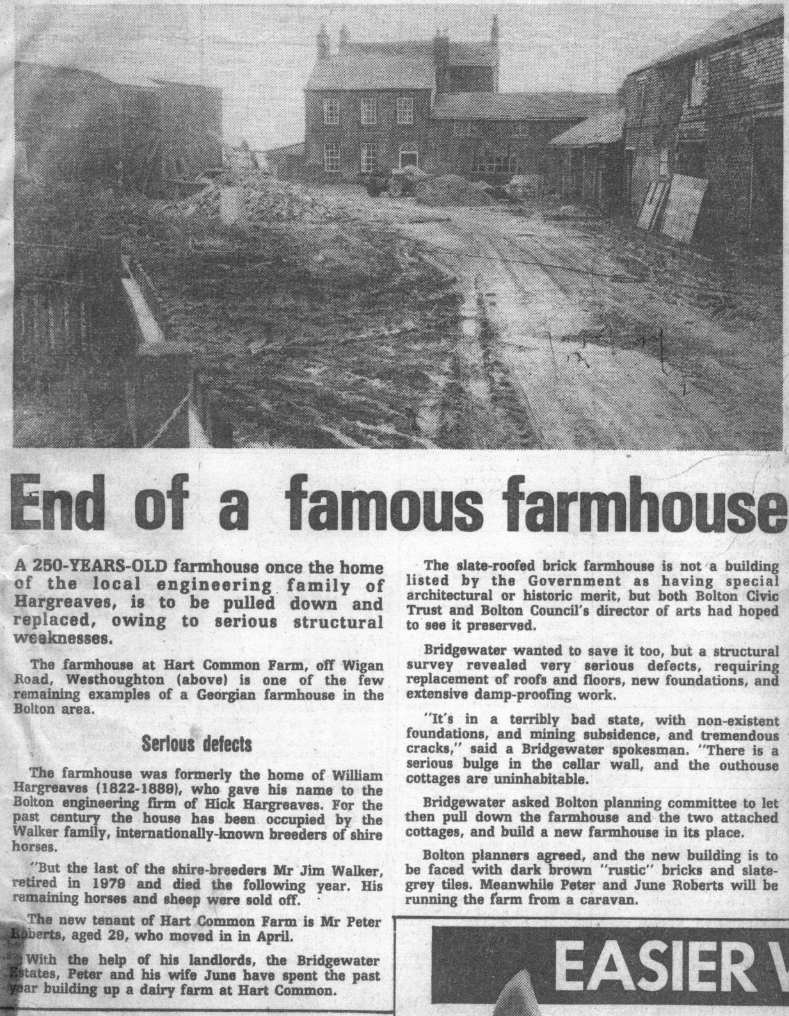
Article in BEN 1981

Slide 20
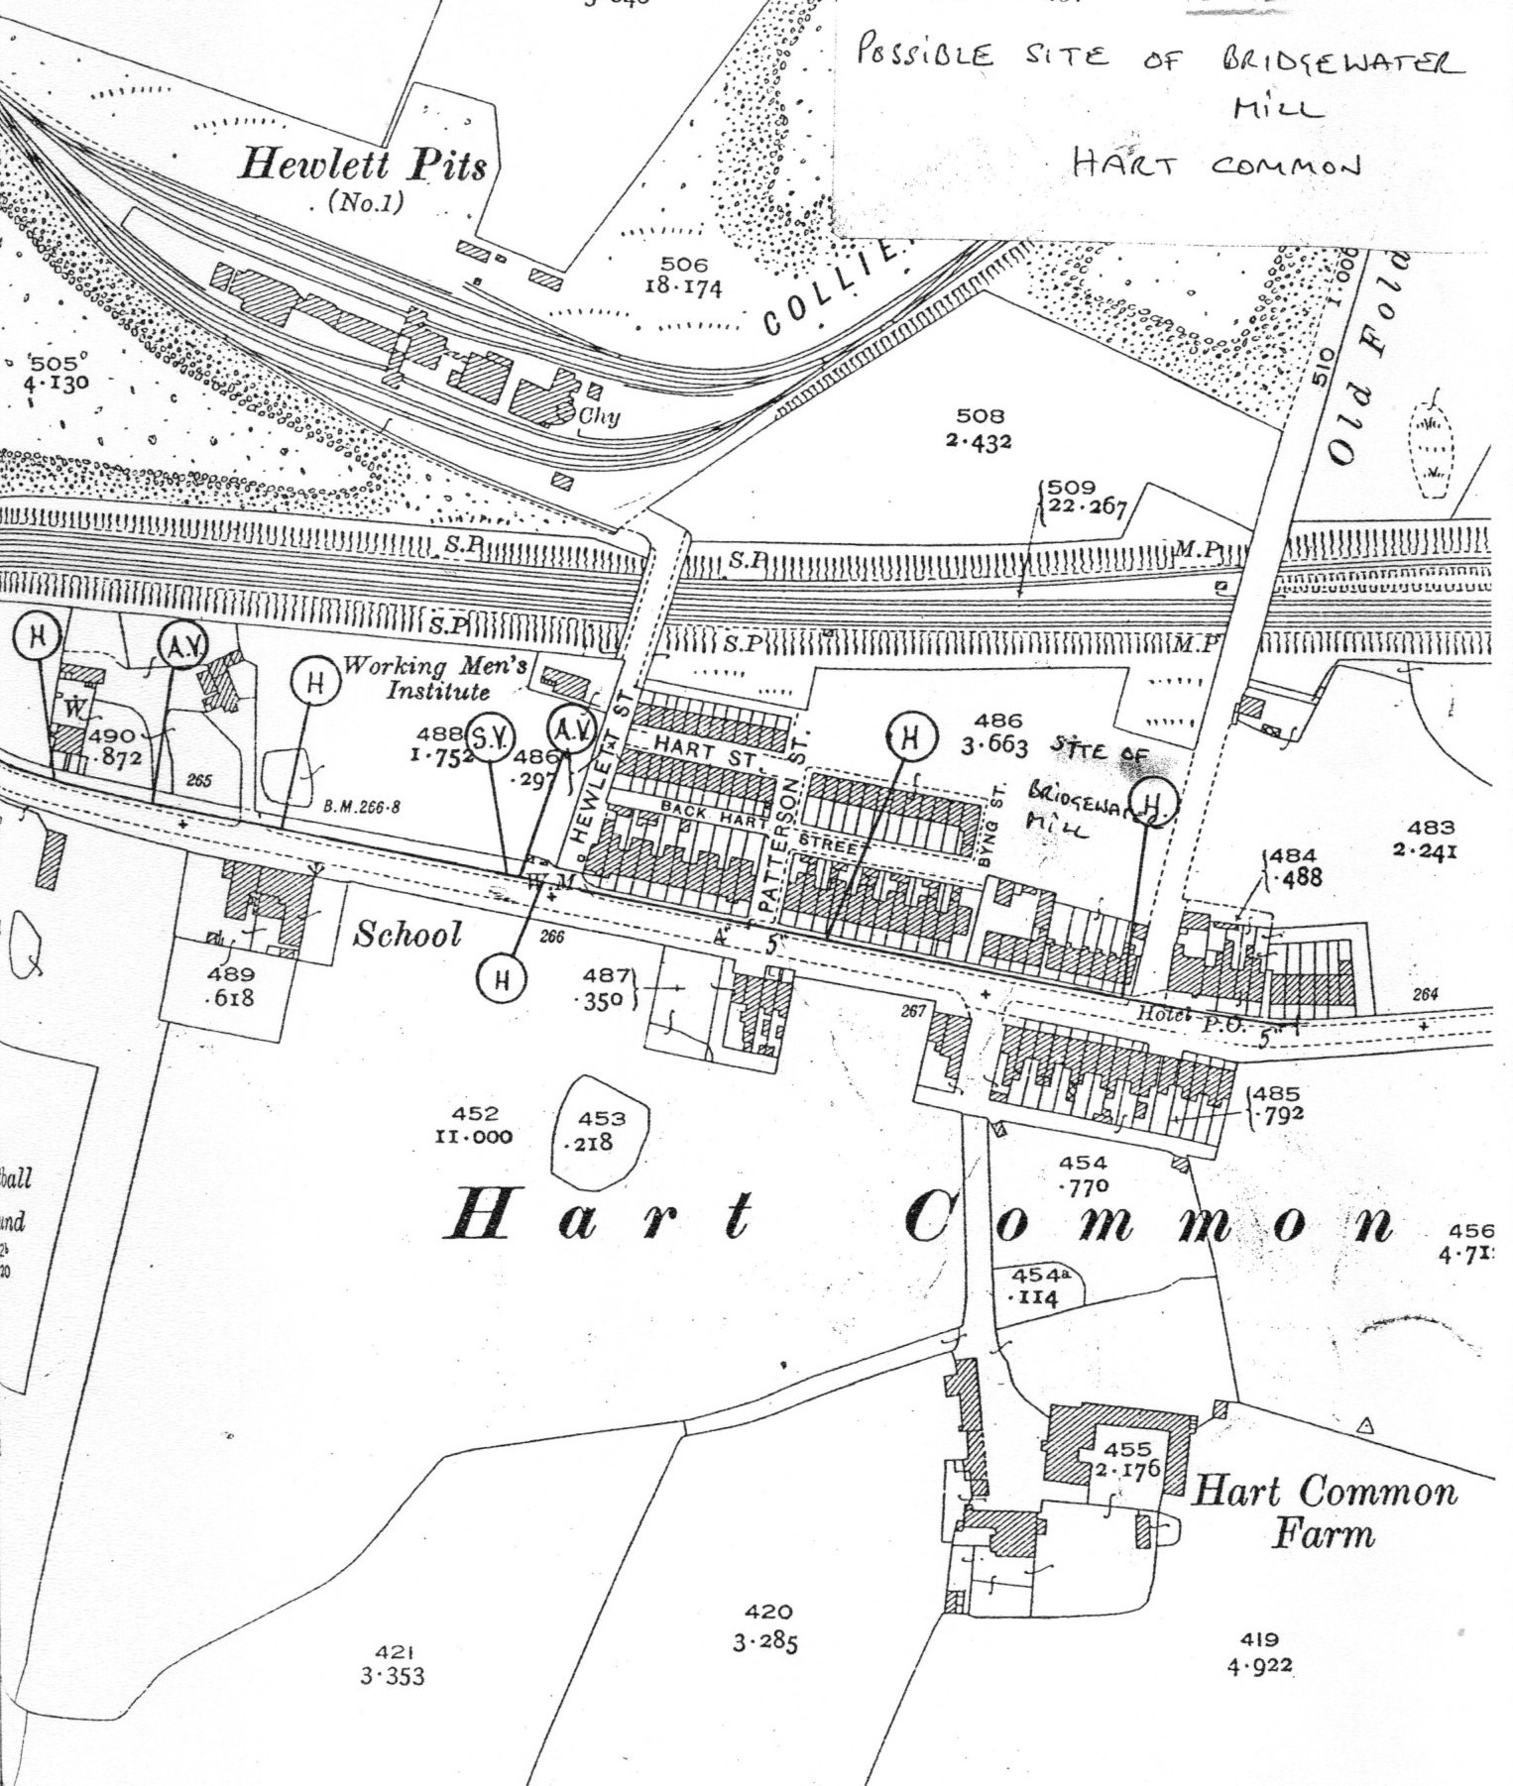
Mill at Hart Common
1892 – no details available

Slide 21
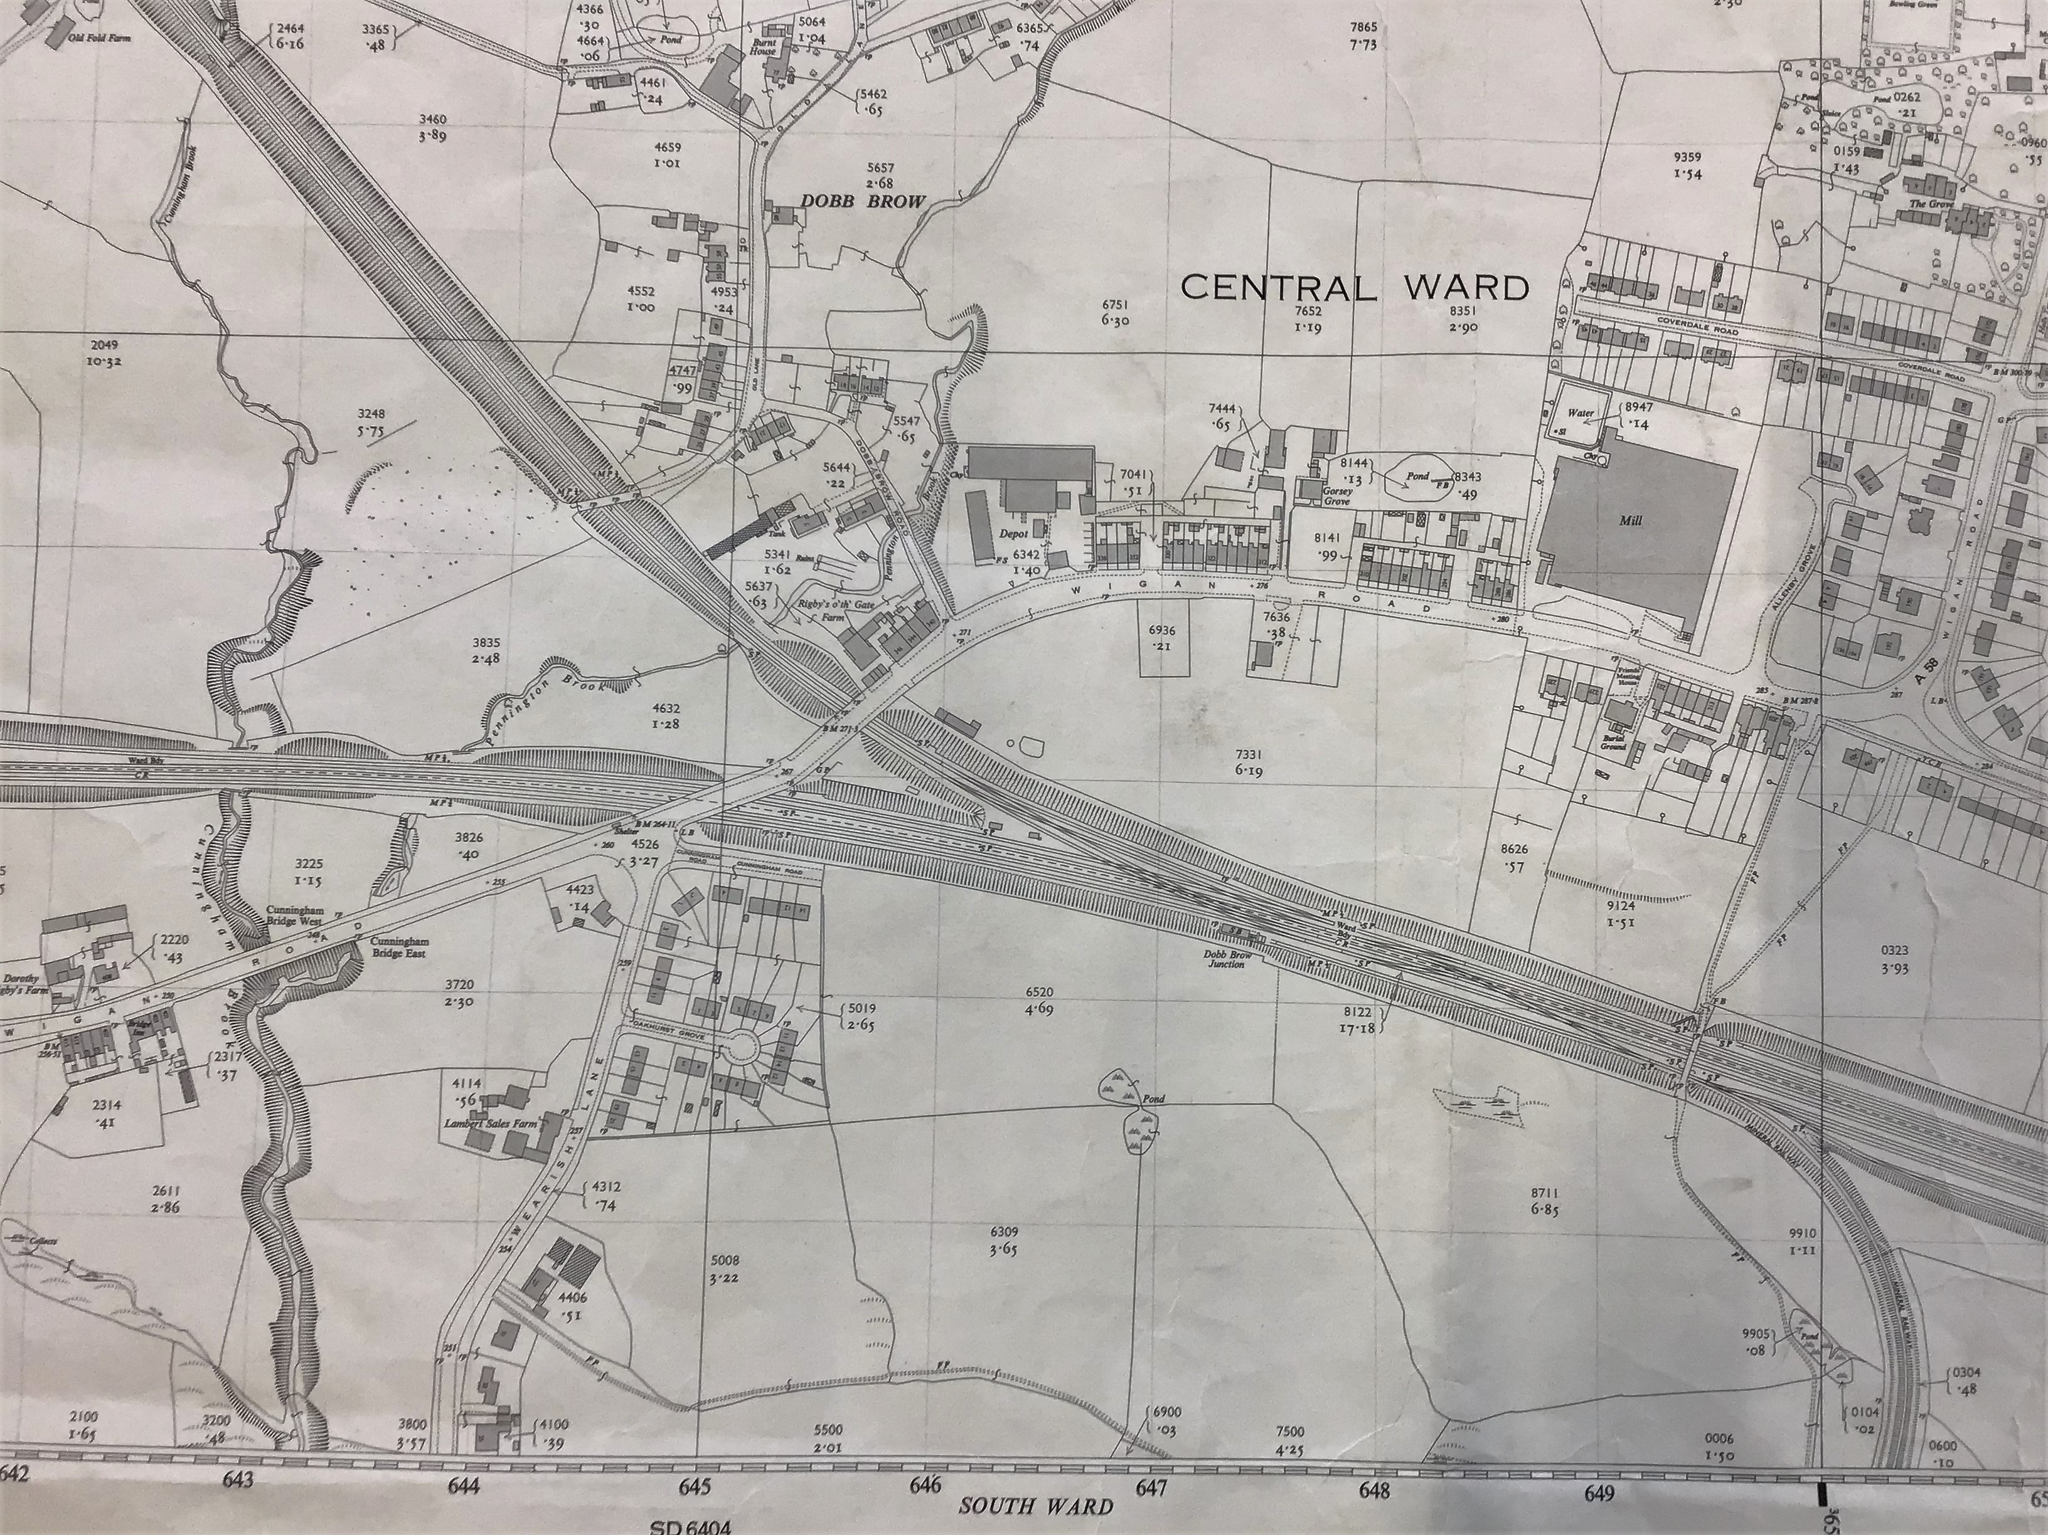
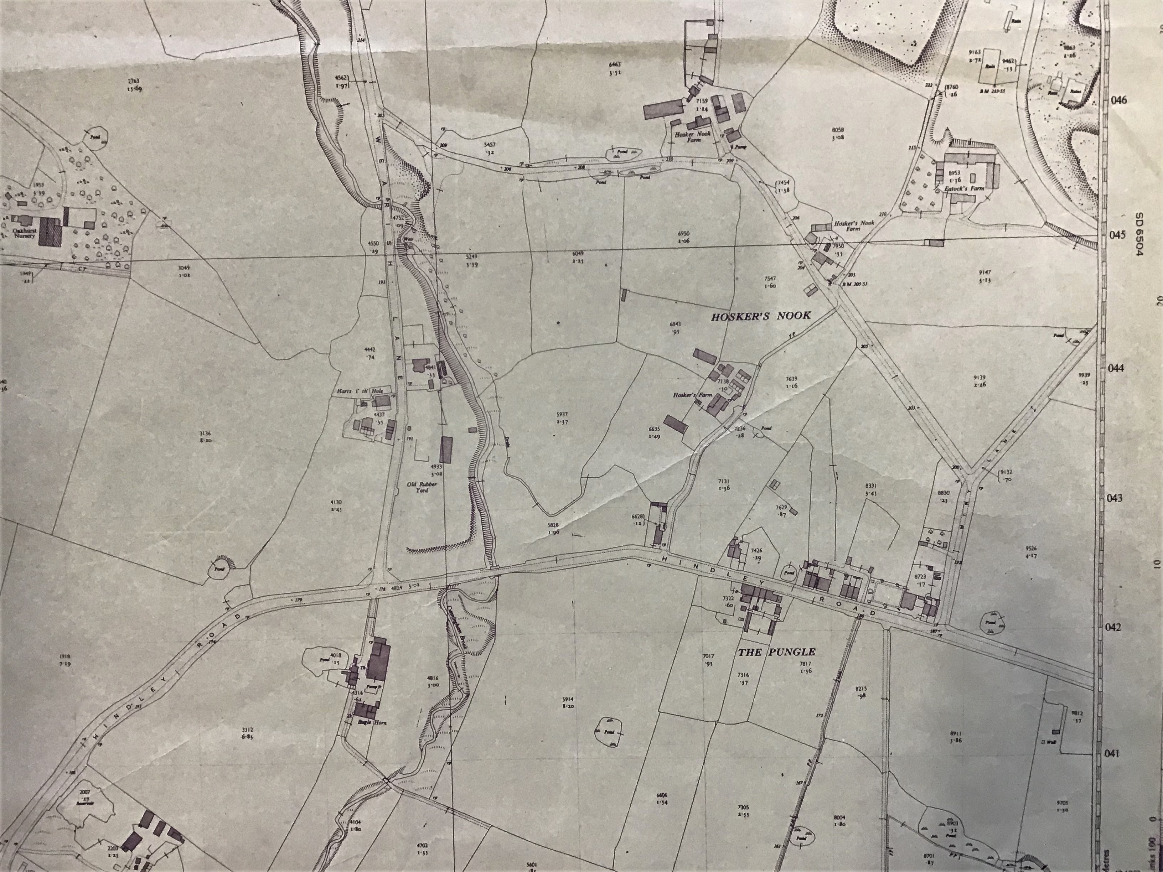
Cunningham Brook
Cunningham Brook runs between Hart Common and Daisy Hill (Pungle)

